Slide 1
Supervisors:
With great power comes great responsibility
Notes:
This session focuses on one of the most important activities in the lab: supervising and mentoring others.
As scientists advance in their careers, this becomes a core responsibility, even though it isn't always formally recognized.
Alongside training, institutional policies, and clear guidelines, good supervision is a foundational part of building a culture of research integrity, and shapes how the next generation of researchers will work.

Slide 2
Your experience
Have you had a good supervisor or mentor in your scientific career?
What makes a supervisor good?
Notes:
One way to make people think about the importance of mentoring or supervision is to ask about their own experience with it.
You could open by asking the audience whether any of them have had a good supervisor, and what characteristics made that person a good supervisor.

Slide 3
A good supervisor
…
…
…
…
Notes:
You can list here the characteristics of a good supervisor suggested by the audience.

Slide 4
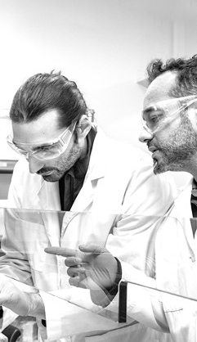
Supervisor or mentor?
Supervision is often task-oriented (e.g., completion of a thesis or dissertation).
Mentoring is more about caring for an individual’s long-term development into a successful professional.
Including mentorship in supervision is ideal!
Notes:
In general, the role of mentoring is being recognised as critical in shaping the professional and ethical development of researchers. Institutions in the UK and US have long acknowledged the importance of mentoring and often have structured mentoring programmes in place. However, mentoring schemes in other parts of the world, including Europe, are not as developed.
It's important to distinguish between supervision and mentoring. Generally, supervision tends to be task-focused, whereas mentorship is more relational. Mentorship involves supporting a mentee's broader personal and professional development.
Further reading:
Scaffidi, A. K., & Berman, J. E. (2011). A positive postdoctoral experience is related to quality supervision and career mentoring, collaborations, networking and a nurturing research environment. Higher Education, 62(6), 685–698. https://doi.org/10.1007/s10734-011-9407-1

Slide 5
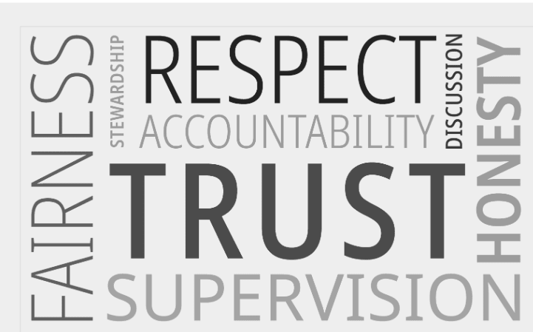
PIs have a special responsibility
For the quality and integrity of the research in their lab.
To help new researchers master the ethical dimensions of research.
To ensure that the values of responsible research are passed on from one generation to the next.
If a lab member commits misconduct, there are repercussions on the PI.
Notes:
Beyond career advice and scientific guidance, supervisors also pass on the values and norms of responsible research to junior lab members. These values are not typically taught formally, but learned via day-to-day interactions, lab culture, and role modelling. Supervisors play a vital role in helping early-career researchers navigate dilemmas and uncertainties they might encounter.
Supervisors might also have a personal interest in being good role models, because, as lab leaders, they are also responsible when things go wrong in their labs.

Slide 6

Supervisor’s responsibilities
With great power comes great responsibility!
Notes:
As scientists take on supervisory roles, they also take on significant ethical responsibilities. It is no longer just about producing results, but ensuring that people in the lab are trained, supported, and guided in how to conduct research responsibly.
As the saying goes, "With great power comes great responsibility." Supervisors are role models, whether they intend to or not – what they say and do sets the tone for the entire lab.

Slide 7
Early career researchers
Researchers in the earliest phases of their career
might not know that some practices are wrong.
might not be aware of the consequences.
Early career researchers cannot be expected to just know things!
Notes:
Most early-career researchers do not set out to commit misconduct or cheat, but they might do it without realizing that they are doing something wrong, especially if they have not received explicit guidance for what is and isn't acceptable.
As an anecdote, you could mention a real example from a lab: a PhD student had been adjusting figures in a paper to make them "clearer." The student didn't realise that altering image data could be considered misconduct. It came to light when the journal requested source data for the figures — the figures didn't match the source data. Of course the PI was alarmed, but she realised after the fact that she had never explicitly said that this form of image modification went against best practice. The student might have been used to improving her own photos and did not realize that editing images for a publication without disclosing it is not allowed. The PI decided to run sessions for newcomers in the lab to explain how to process images for publications.
This example demonstrates the importance of clear communication in a supervising role.

Slide 8
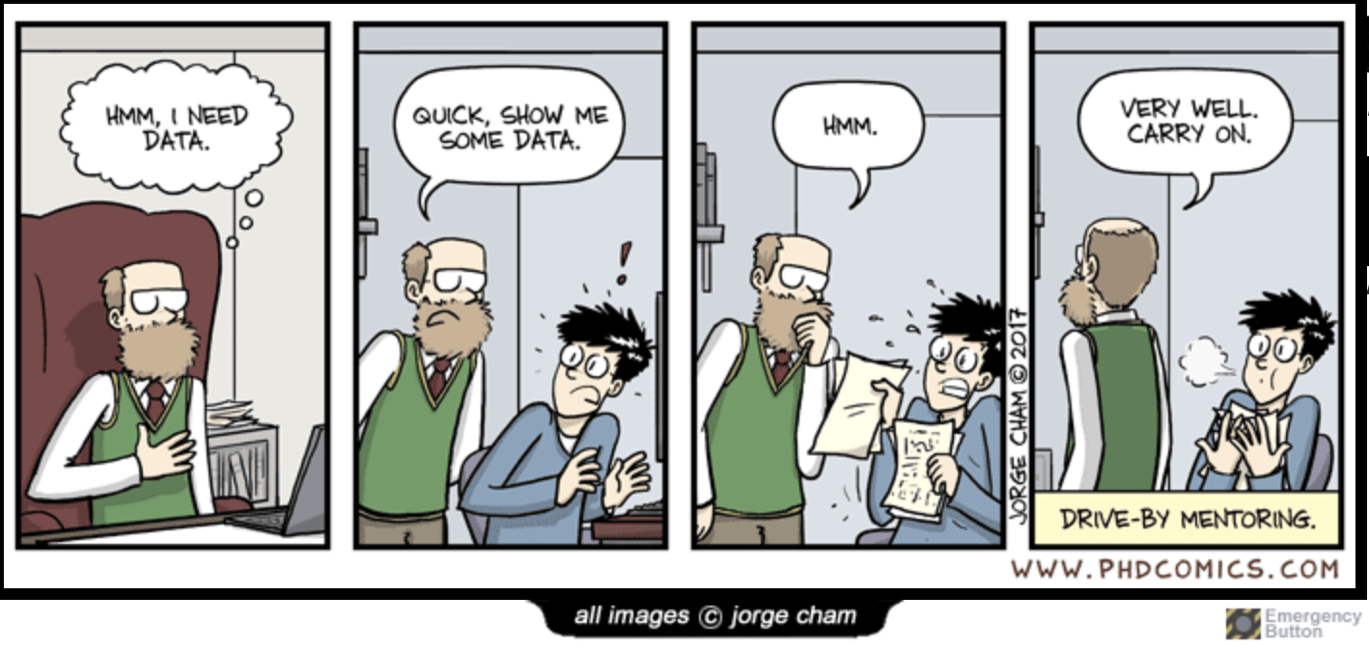
Consequences of poor supervision
Review of 45 ORI cases between 1990–2004 in which a trainee was found guilty of scientific misconduct. Most of the cases involved fabrication, falsification or both.
73% of mentors/PIs had not looked at the raw data generated by the trainees
62% of mentors had not set standards for recording data
53% of trainees reported stress levels as a relevant factor contributing to their misconduct.
Source: Wright, Titus & Cornelison (2008), Science and Engineering Ethics.
Notes:
Poor supervision can have disastrous effects on the integrity of the research in the lab.
This slide shows data from a 2008 analysis of 45 closed cases of research misconduct processed by the US Office of Research Integrity, involving 33 postdocs, 10 graduate students and 2 other trainees. Most of the cases involved serious misconduct such as fabrication or falsification of data.
It highlights two major failings in supervision:
Failure to check raw data: in the majority of cases, mentors had not reviewed the trainees' raw data.
Failure to set clear standards for data recording and data management: labs lacked protocols or training on how to properly document and store data.
The study also showed that 53% of trainees cited stress as a factor in their misconduct.
These figures suggest that improving supervision could significantly reduce cases of misconduct.
In relation to the comic strip, here you could ask the audience: “Ever experienced or seen anything similar?”
Source:
Wright, D. E., Titus, S. L., & Cornelison, J. B. (2008). Mentoring and research misconduct: An analysis of research mentoring in closed ORI cases. Science and Engineering Ethics, 14(3), 323–336. https://doi.org/10.1007/s11948-008-9074-5

Slide 9
Trainee’s admission of misconduct
There was much excitement over this surprising and promising preliminary result, and I began to feel a self-imposed pressure to keep the positive data coming in. It was at this time that I began to substitute buffer for the control xxx. (…) Over time I lost more and more control and felt like I could not stop falsifying experiments.
Trainee quoted in Wright et al. (2008)
Takeaway message:
Be critical, is it too good to be true​?
Be open to mistakes
Source: Wright, Titus & Cornelison (2008), Science and Engineering Ethics.
Notes:
In the analysis of the same cases, one of the trainees talks about the stress levels and pressure that contributed to their misconduct.
This shows how the pressure by a supervisor to keep on producing good or positive results can influence lab members' practices, as fear of losing momentum or disappointing the supervisor can be strong. That's why it is so important to create a lab culture where:
Preliminary results are treated with healthy scepticism
Mistakes are acknowledged and corrected openly
Researchers feel safe raising concerns
Mentors are responsible for modelling critical thinking and caution, and for helping their lab members understand that if something seems too good to be true, it probably is.
Source:
Wright, D. E., Titus, S. L., & Cornelison, J. B. (2008). Mentoring and research misconduct: An analysis of research mentoring in closed ORI cases. Science and Engineering Ethics, 14(3), 323–336. https://doi.org/10.1007/s11948-008-9074-5

Slide 10
Good supervision shapes ERC wellbeing and retention
Across 2,604 anonymous responses from predoctoral, postdoctoral and former researchers in 65 countries, supervisory behaviour emerged as a major factor in mental health and decisions to stay in academia.
76%
said that their supervisor’s attitude had a moderate or severe impact on mental health
48%
of former researchers named negative supervisory experiences as a reason for leaving academia
Source: Martínez-Goñi et al. (2026), bioRxiv preprint.
Notes:
Mental health plays an important role in the relationships within labs, and supervisors also have a responsibility to care for the wellbeing of their lab members. A healthy research environment is more likely to keep young researchers in academia.
This slide presents findings from a survey of 2,604 anonymous respondents (predoctoral, postdoctoral and former researchers) across 65 countries. Overall, 76% of respondents reported that their supervisor's attitude had a moderate or severe impact on mental health. Although most entered academia for vocational reasons, negative experiences with supervisors were among the most frequently reported reasons for leaving among former researchers (48%), comparable to job insecurity and financial instability. Harm was most often associated with poor communication, disregard for wellbeing, micromanagement and competitiveness.
These findings highlight the importance of creating and maintaining a positive research culture in the lab.
Sources:
Martínez-Goñi, X. S., Marín-Peña, A. J., Corrochano-Monsalve, M., & Bozal-Leorri, A. (2026). With great power comes great responsibility: How scientific supervisors shape the wellbeing of early-career researchers [Preprint]. bioRxiv. https://doi.org/10.64898/2026.05.05.722947
Poor supervision is pushing young researchers out of academia. (2026). Nature. https://www.nature.com/articles/d41586-026-01693-4

Slide 11
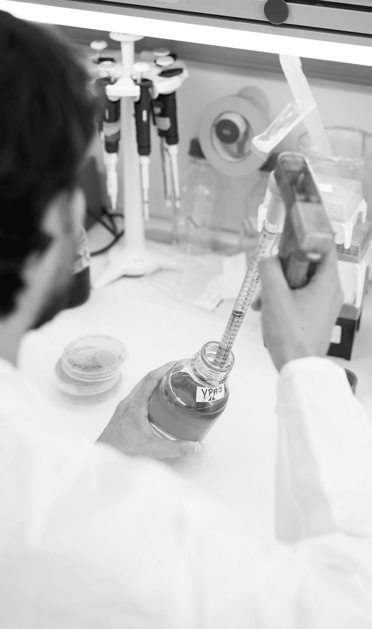
Bad supervision and research integrity
The "STAP cell" case (2014): a widely publicized stem-cell breakthrough was retracted after the data were found to be falsified.
The lead researcher's supervisor was cleared of personal involvement in the misconduct, but was criticized for poor mentoring and for not checking the data.
Poor data management and mislabelled samples made it impossible to trace where samples had come from.
Source: Cyranoski (2014), Nature.
Notes:
This case is described in more detail in the first slide deck of this resource, "Research Integrity: What it is and why should we care?”
Lack of supervisor's oversight was an element in the "STAP cell" case. Misconduct was found already in the researcher's PhD thesis. Her supervisor was cleared of involvement in the misconduct but was criticized for poor mentoring and found responsible for not checking the data. During the investigation, because of poor data management and the failure to properly label samples in the laboratory, it was impossible to know exactly where the samples came from. Extreme carelessness was found also in the way lab books were kept.
This case shows that even when a supervisor is not personally involved in misconduct, insufficient oversight and poor data checking can still have serious consequences for the lab and the institution.
Source:
Cyranoski, D. (2014, April 1). Stem-cell scientist found guilty of misconduct. Nature. https://doi.org/10.1038/nature.2014.14974

Slide 12
What can a supervisor do to foster research integrity?
Notes:
Supervisors have power to shift from identifying problems to proposing solutions. The next slides will outline practical examples and recommendations.

Slide 13
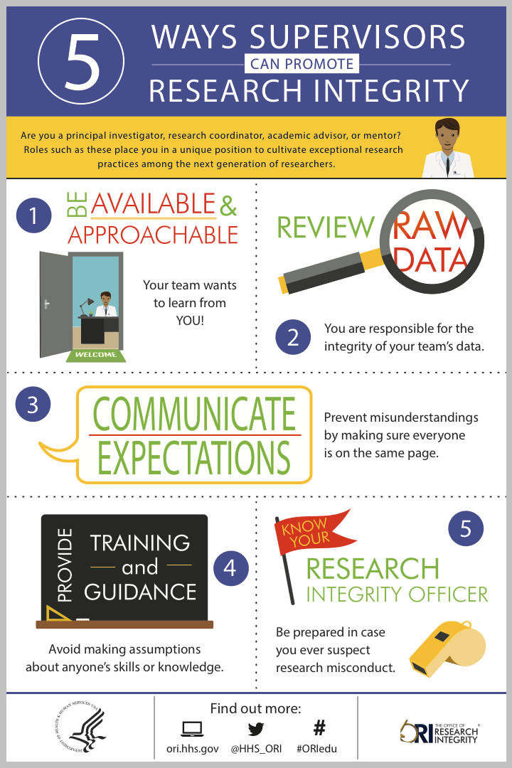
What can a supervisor do?
Be available and approachable
Review raw data
Communicate expectations
Provide training and guidance
Know your research integrity officer
Dedicate group meetings to discussions of
scenarios
Source: Office of Research Integrity (n.d.), 5 ways supervisors can promote research integrity.
Notes:
The infographic on the right was published by the US Office of Research Integrity, and it suggests five practical tips for supervisors to promote research integrity:
Be available and approachable: set regular meetings, take time for your lab members.
Review raw data: supervisors are accountable for the data originating in their labs. Reviewing it helps to catch both errors and intentional misconduct early.
Communicate expectations: define roles, responsibilities, authorship and timelines early on to reduce stress.
Provide training and guidance: don't make assumptions about people's knowledge, and make sure everyone is at the same level.
Know your research integrity officer: be prepared in case a situation arises, and share their contact information with lab members so that people know where to go for advice or to report issues.
You could suggest that the audience download and print this infographic and post it in their lab as a visible reminder to everyone.
As an anecdote, you can tell the story of a case where a PI judged a PhD student and thought that they were a poor researcher because they couldn't reproduce the experiments done by a trusted postdoc in the lab. It came out later that the postdoc's experiments had been falsified, so the problem was not the student's skill, but the integrity of the data produced by the postdoc. So never make assumptions about the skills or knowledge of lab members.
Source:
Office of Research Integrity. (n.d.). New infographic: 5 ways supervisors can promote research integrity. U.S. Department of Health and Human Services. https://ori.hhs.gov/blog/new-infographic-5-ways-supervisors-can-promote-research-integrity

Slide 14
Clear instructions on lab practices
Data collection, storage, and back up
How to keep a lab notebook.
Safety rules
Responsibilities of each team member
Authorship policy
How to prepare images for publication
You are a role model!
Notes:
There are a few things that lab leaders can do to provide clarity on lab practices.
One thing we would recommend is looking into the use of electronic lab notebooks, as they give supervisors constant access to lab data, and every change is recorded, making it easy to trace what happened. You could ask the audience whether any of them use lab notebooks, and start a discussion on their pros and cons.
Authorship issues are one of the main problems in labs, and are the most frequent cause of conflicts that Research Integrity Officers must solve. You could suggest introducing a lab-level authorship policy that requires authorship to be discussed before starting a project, and ask the audience whether any of them have developed such a policy and how it works out in practice.
Also, it is important to remember that supervisors are role models, and problematic behaviours can be passed down to the next generation of researchers.

Slide 15
Examples of questionable research practices
Research stage | Example of questionable research practices
Planning | Biased study design: select methods/controls that favour wished results Too small sample size Failure to disclose conflicts of interest
Conducting | Inadequate procedures for recording or storing data; sloppiness in keeping lab notebooks Reuse of controls from past experiments Inadequate supervision of lab members
Interpreting | Inappropriate statistical methods Exclusion of outliers and negative results without justification Adding data points to a curve Unjustified or unsupported conclusions
Publishing | Statistical tricks to obtain statistical significance (P-hacking) Misattribution of authorship Unjustified modification, reuse, relabelling of images Salami slicing
Reviewing | Failure to maintain confidentiality Stealing ideas or text from a manuscript Failure to declare conflicts of interest Conscious bias toward or against colleagues, fields, methodologies
Source: Adapted from Steneck (2007).
Notes:
One way that PIs could raise awareness about research integrity issues is by dedicating some time during regular lab meetings to discussing questionable research practices, or by walking lab members through scenarios of real misconduct cases and discussing how to avoid such situations. The examples shown in this slide could be used as discussion prompts, with a specific topic addressed each month.
This table also appears in Slide Deck 1, “Research Integrity: What it is and why we should care”, so if you are presenting both to the same audience, you could recap it briefly here rather than covering it in full again.
Source:
Steneck, N. H. (2007). ORI introduction to the responsible conduct of research (Rev. ed.). Office of Research Integrity, U.S. Department of Health and Human Services. https://ori.hhs.gov/ori-introduction-responsible-conduct-research

Slide 16
Signs of possible problems
Source: Office of Research Integrity (n.d.), Possible red flags of research misconduct.
Notes:
This is another infographic from the US Office of Research Integrity describing warning signs that something might be going wrong in the lab.
It groups red flags into three categories:
Time: usable data only appear when there's a pressing deadline, or experiments are completed faster than usual.
Results: data seem too good to be true, or findings can't be replicated by others in the lab.
Lack of transparency: raw data can't be produced on request, materials and protocols are kept hidden, or work is mostly done when no one else is around.
This highlights the importance of being critical and attentive to what happens in the lab. None of these signs alone proves misconduct, but together they're worth a closer look.
You could ask the audience whether they have ever noticed any of these signs in their own lab, and how they responded.
Source:
Office of Research Integrity. (n.d.). Possible red flags of research misconduct [Infographic]. U.S. Department of Health and Human Services. https://ori.hhs.gov/possible-red-flags-research-misconduct

Slide 17
Common problems in labs
Conflicting interests
Supervisor-mentee competition: failure to see that mentee’s success reflects well on the supervisor
Peer competition among lab members
Lack of clarity on authorship policies
Poor communication about roles, goals and expectations
Lack of oversight
Lack of instructions
Not regular checking of data
Other factors?
Source: Straus et al. (2013), Academic Medicine.
Notes:
This slide shows some of the most common problems in labs.
Conflicting interests can come up when:
Financial or career ambitions of the mentor that get in the way of their responsibility to trainees
A mentor takes credit for the trainee's work
Expecting the trainee to dedicate long hours to the mentor's project at the expense of the trainee's development
Supervisors should remember that what is good for them, professionally and personally, is not necessarily good for their trainees, and they have an ethical responsibility to prioritize the intellectual growth and independence of the trainees.
Here you could ask the audience whether they have experienced any of these problems themselves, either as a trainee or a supervisor, and how they were handled. Or if they think other factors create problems in labs.
Source:
Straus, S. E., Johnson, M. O., Marquez, C., & Feldman, M. D. (2013). Characteristics of successful and failed mentoring relationships: A qualitative study across two academic health centers. Academic Medicine, 88(1), 82–89. https://doi.org/10.1097/ACM.0b013e31827647a0

Slide 18
“There is nothing wrong with being wrong”
Common sources of errors
Mitigation
Ignorance, arrogance, being in a hurry, feeling pressure to get the ‘right’ results
Encourage researchers to be completely open about mistakes, flaws and inconsistencies in experimental design and data collection
Foster collaboration, not competition; ensure individuals are not singled out for blame
Blame-free reporting of incidents is key!
Source: Fiona Watt, EMBO Director (personal communication).
Notes:
One way PIs can mitigate problems is to be open about mistakes, flaws, and inconsistencies in their own work. This approach helps remove fear of blame, creating an environment where trainees feel safe to admit to errors.
The title of this slide is a motto used by Fiona Watt, who advocates for learning from mistakes in science. Other lab leaders could adopt it in their own labs.
To make the discussion interactive and encourage the audience to reflect, you could ask them: "How do you react to mistakes by your lab members, particularly when they are not disclosed but found by accident? Has this ever happened to you, and how did you react? Do you ever tell your lab members that mistakes are learning opportunities and should be shared?”
Source:
Watt, F. (EMBO Director). Personal communication.

Slide 19
What can institutes and funders do to foster good supervision?
Notes:
As we saw earlier, the responsibility for fostering good supervision is not only with scientists. Other stakeholders, research performing organizations and funders in particular, also play an important role in promoting effective mentoring and supervision.

Slide 20
How can institutes help PIs supervise well?
Provide lab management and supervision training
Require supervision training before a PI takes on their first student or postdoc
Fund training for lab members in statistics, data management, image preparation, and research integrity
Organize mentoring schemes for early-career PIs
Acknowledge and reward supervision in PIs’ performance assessment and promotion
Provide extra support for PIs with large labs
Does your institute offer training or support for supervisors?
Notes:
This slide suggests some practical ways institutes can support their PIs. These include a training approach and explicitly rewarding supervision in performance assessment and promotion, so it is not seen as unpaid, invisible labour.
You could ask the audience whether their institute offers any training or support for supervisors, and whether a mentoring scheme already exists. If the answer is no, you can encourage the audience to suggest to their leadership to look into some of these options. Concrete examples of institutes that have already done this are shown on the next slide.
Further reading:
Howard Hughes Medical Institute & Burroughs Wellcome Fund. (2006). Making the right moves: A practical guide to scientific management for postdocs and new faculty (2nd ed.). https://www.hhmi.org/sites/default/files/Educational%20Materials/Lab%20Management/Making%20the%20Right%20Moves/moves2.pdf
Resources for Research Ethics Education, UC San Diego. (n.d.). Mentoring. http://research-ethics.org/topics/mentoring/
University of Toronto, School of Graduate Studies. (n.d.). Supervision guidelines for faculty, Section 2: Supervision and mentoring. https://www.sgs.utoronto.ca/supports/supervision/supervision-guidelines/supervision-guidelines-for-faculty-section-2-supervision-and-mentoring/

Slide 21
Institutional support in practice
University Medical Center Utrecht: PIs are evaluated on the quality of their mentorship, not just the number of PhD students they supervise; a “Supervisor of the Year” award recognizes outstanding mentors.
Karolinska Institute: promotion portfolios must cover supervision, teaching and reviewing, alongside scientific contributions.
KU Leuven: new lab members receive a standard onboarding checklist covering authorship, safety and institutional resources.
Independent mentor schemes: some funders (e.g. Wellcome Career Development Awards) ask applicants to identify a mentor with a track record in training and mentorship.
Sources: Utrecht University (n.d.); KU Leuven (n.d.); Wellcome (n.d.).
Notes:
This slide gives concrete examples of institutions that have already put supervision-support policies into practice, to make the previous slide's suggestions less abstract.
At the University Medical Center Utrecht, supervisors are evaluated on the quality of their mentorship, not just the number of PhD students they have supervised. There is even a "Supervisor of the Year" award.
At the Karolinska Institute, candidates for promotion must submit a portfolio covering scientific and teaching contributions, as well as supervision, reviewing for journals, and committee work.
At KU Leuven in Belgium, supervisors receive a standard checklist when a new lab member starts, covering authorship policies, health and safety, and institutional resources.
Some funders now encourage a named, independent mentor separate from the direct supervisor – for example, Wellcome Career Development Awards ask applicants to identify a mentor with a track record in training and mentorship.
You could ask the audience which, if any, of these mechanisms already exist at their institute, and which they think would be most useful to introduce.
Sources:
KU Leuven. (n.d.). Checklist for doctoral researchers and their supervisors. https://research.kuleuven.be/en/integrity-ethics/integrity/Checklist
Utrecht University, Graduate School of Life Sciences. (n.d.). Supervisor of the Year award. https://www.uu.nl/en/education/phd-at-the-graduate-school-of-life-sciences/during-your-phd/events/supervisor-of-the-year-award
Wellcome. (n.d.). Wellcome Career Development Awards. https://wellcome.org/research-funding/schemes/wellcome-career-development-awards#how-applications-are-assessed-5bbb

Slide 22
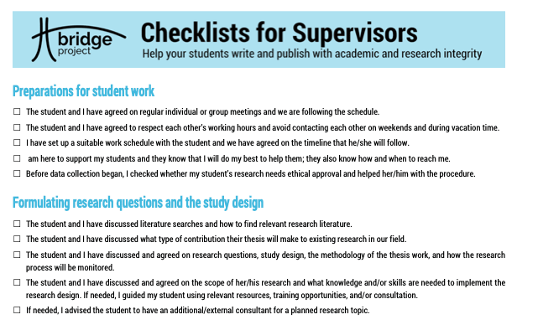
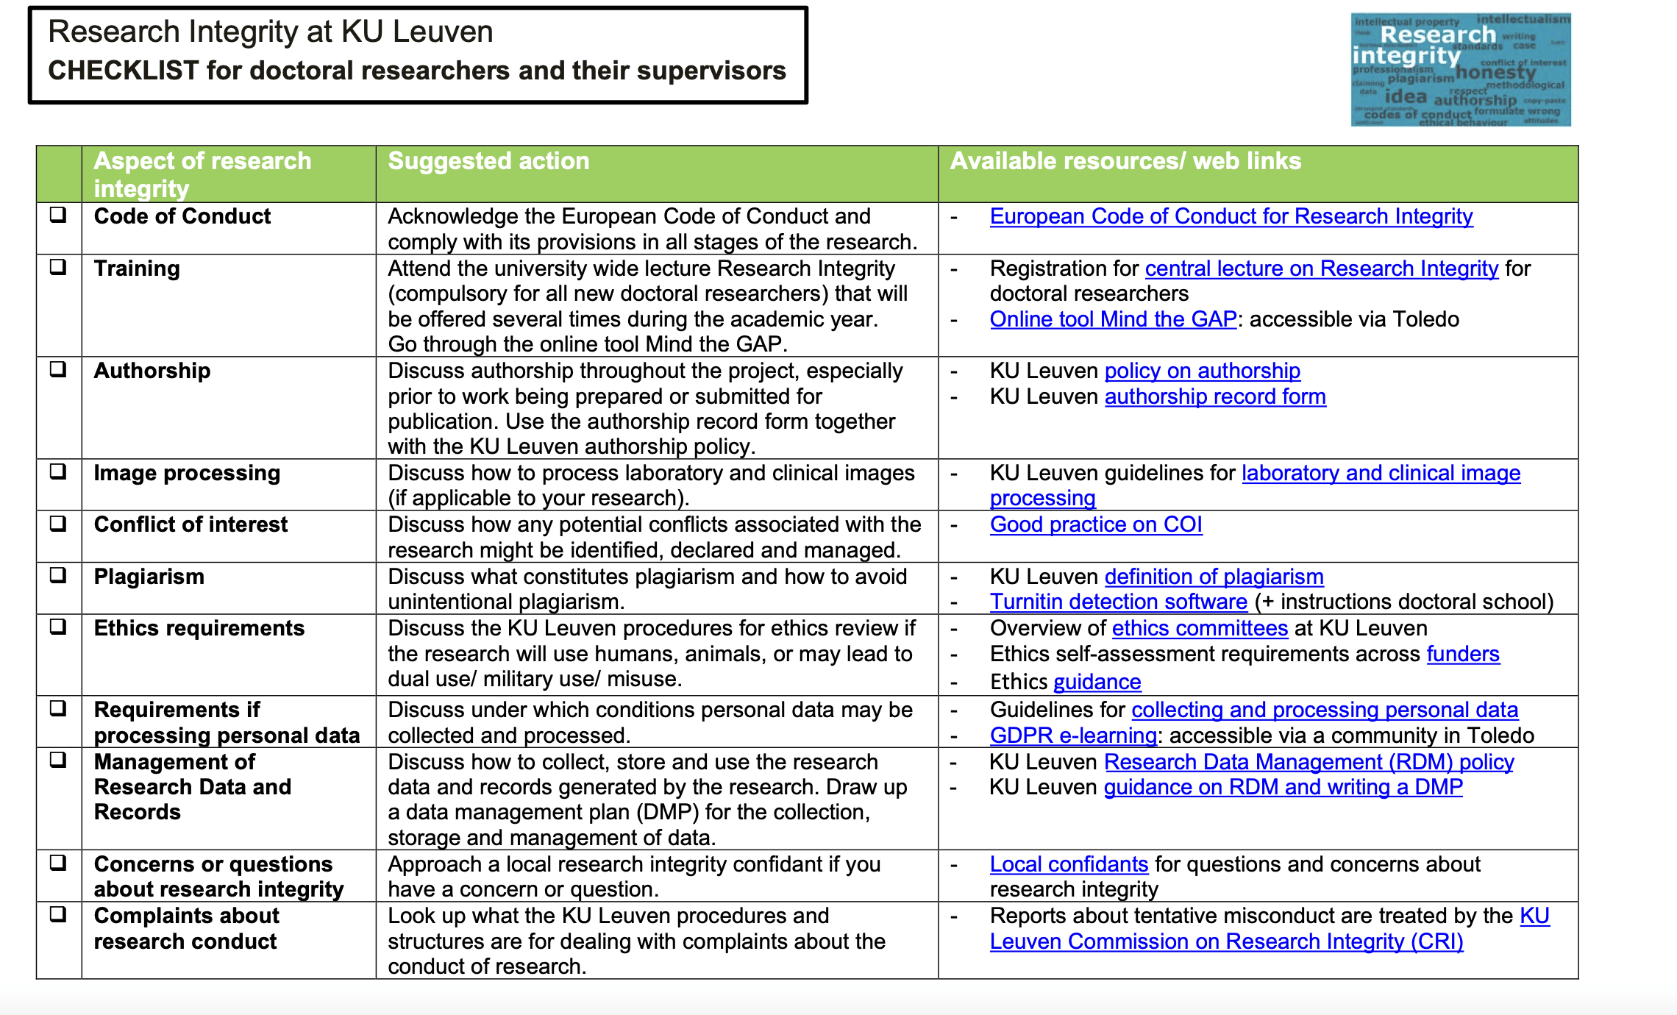
Supervisor checklists in practice
Bridge Project (EU-funded): a checklist for supervisors outlining specific points to address with trainees when discussing research projects, covering communication, expectations, and ethics.
KU Leuven: new lab members receive a checklist at onboarding covering authorship policies, health and safety, and institutional resources.
Sources: BRIDGE project (n.d.), Checklists for supervisors (left); KU Leuven (n.d.), Checklist (right).
Notes:
This slide shows two examples of supervisor checklists.
The EU-funded Bridge Project developed a checklist for supervisors that outlines specific points to address with trainees when discussing research projects, covering communication, expectations, and ethics. Such tools help standardise good mentoring practice and reduce misunderstandings.
At KU Leuven in Belgium, supervisors receive a similar checklist when a new lab member starts, covering authorship policies, health and safety, and institutional resources. This ensures onboarding includes all relevant information and helps establish clear expectations from day one.
You could ask the audience whether they use any checklist for interacting with their lab members. If not, you could suggest developing one similar to these two examples.
Sources:
BRIDGE project. (n.d.). Checklists for supervisors. https://www.academicintegrity.eu/wp/bridge-checklists/
KU Leuven. (n.d.). Checklist for doctoral researchers and their supervisors. https://research.kuleuven.be/en/integrity-ethics/integrity/Checklist

Slide 23
Dedicated leadership and supervision training
Some institutes run dedicated courses in lab leadership, negotiation and research integrity for PIs.
Example: EMBO Lab Leadership (embolableadership.org)
Example: HHMI’s laboratory management and mentoring resources (hhmi.org/shaping-science/science-leadership-lab-culture)
Check whether your own institute offers similar training for new PIs
Examples are illustrative, not exhaustive or an endorsement
Notes:
This slide makes the general point that dedicated leadership and management training exists and is worth pointing PIs towards, with a couple of illustrative examples.
The examples given (EMBO Lab Leadership, HHMI's laboratory management resources) are illustrative, not exhaustive or an endorsement.
When adapting this deck, you can replace these with whatever leadership or management training your own institute or a relevant funder offers.
You could ask the audience whether they are aware of any such training at their own institute, and whether they have taken it.

Slide 24
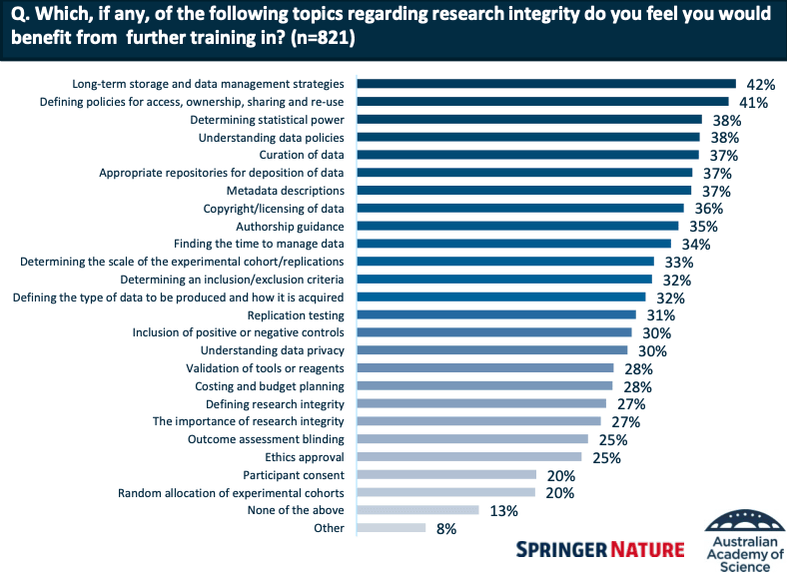
Survey of researchers’ training needs
Long-term storage and data management strategies
Defining policies for access, ownership sharing
and re-use
Determining statistical power
Understanding data policies
Curation of data
Appropriate repositories for deposition of data
Metadata descriptions
Copyright/licensing of data
Authorship guidance
Source: Springer Nature & Australian Academy of Science (2022).
Notes:
This slide grounds the previous suggestions in actual demand: it shows what researchers themselves asked for when they were surveyed directly about their training needs.
In 2022, the Australian Academy of Science and Springer Nature surveyed researchers about their research integrity training needs. The most requested training topics were:
Long-term data storage and management
Policies for data access, ownership, sharing, and reuse
Statistical power and analysis
Data policies and curation
Choosing repositories, using metadata, and meeting copyright/licensing requirements
Authorship guidance
These priorities are heavily focused on data management and other practical, everyday skills rather than abstract ethics content – and they came directly from researchers themselves, not from institutions guessing what might be useful.
You could ask the audience which of these topics they feel least confident about, or whether their own institute currently offers training in any of them.
Source:
Springer Nature & Australian Academy of Science. (2022). Research integrity – A survey looking at needs and provision of training in Australian institutions [Presentation]. figshare. https://doi.org/10.6084/m9.figshare.19773298

Slide 25
Funders are rewarding supervision
Over 830 organisations have signed CoARA, the Agreement on Reforming Research Assessment, which asks institutions to recognize supervision, mentoring and training as core research contributions – not just publications.
UKRI’s Résumé for Research and Innovation (R4RI) replaces the
traditional CV with a narrative format that includes a dedicated module for mentoring and training.
Wellcome explicitly assesses contributions to teaching and mentorship in its award schemes.
The Royal Society’s Résumé for Researchers is a narrative CV template, used as a model by several funders, that asks about supervisory contribution rather than publication count alone.
Sources: CoARA (2022); UK Research and Innovation (n.d.); Wellcome (n.d.); The Royal Society (n.d.).
Notes:
This slide connects supervision to the broader research assessment reform movement, and shows that recognising supervision is not only good practice, but increasingly something funders and assessment frameworks expect to see. More details on the movement are included in Slide Deck 3: How Research Assessment Affects Research Conduct.
CoARA, the Coalition for Advancing Research Assessment, asks signatory institutions to recognize the diversity of research contributions, explicitly including training, mentoring and supervision, rather than relying only on publication metrics. Over 830 organizations worldwide have signed the agreement.
UKRI's Résumé for Research and Innovation (R4RI) replaces the traditional track record with a narrative CV that includes a dedicated module where applicants can describe their contribution to mentoring and training others.
Wellcome asks senior applicants to name a mentor with a track record in training and mentorship, and its broader funding schemes assess contributions to teaching, mentorship and leadership as part of the application.
The Royal Society's Résumé for Researchers is a narrative CV format that several other funders have used as a model; like R4RI, it asks about supervisory contribution rather than counting outputs alone.
Sources:
CoARA. (2022). Agreement on reforming research assessment. https://www.coara.org
The Royal Society. (n.d.). Résumé for Researchers. https://royalsociety.org/news-resources/projects/research-culture/tools-for-support/resume-for-researchers/
UK Research and Innovation. (n.d.). Résumé for Research and Innovation (R4RI) template. https://www.ukri.org/publications/resume-for-research-and-innovation-r4ri-template/
Wellcome. (n.d.). Wellcome Career Development Awards. https://wellcome.org/research-funding/schemes/wellcome-career-development-awards#how-applications-are-assessed-5bbb

Slide 26

Ask for support
Do you have access to such training or support at your institute?
PIs can be proactive and ask their institute for support.
Would you like to crate a working group at your institute to look into what training is missing to support PIs and their labs?
Notes:
This slide suggests that PIs can proactively ask for support if their institute does not provide it.
If there’s a gap, whether it’s in training, mentorship, or resources, communicate it to your institute so that solutions can be developed.
Here you could encourage the audience to be proactive and talk to the leadership of their institutes to provide support, or create a working group to look into training and support.

Slide 27
Changelog
October 2026: Original release

Slide 29
These slides were created by EMBO Policy as a public resource. Unless otherwise stated, the content is licensed under CC BY-NC 4.0. You are welcome to reuse and adapt them for non-commercial purposes, provided you credit EMBO. EMBO is not responsible for any adapted versions, and their use does not imply EMBO's endorsement.

