Slide 1
Research Integrity:
What it is and why we should care

Slide 2
Contents
Definitions and principles of Research Integrity (RI)
Institutional contexts
Why RI matters: consequences of research misconduct
Description, types & examples of research misconduct
Three case studies of research misconduct
How frequent is research misconduct?
Who is responsible?
Systemic factors: research assessment & publish-or-perish culture
Solutions

Slide 3
Research integrity is…
The use of honest and verifiable methods in proposing, performing, and evaluating research,
Reporting results with particular attention to adherence to rules, regulations, guidelines,
Following commonly accepted professional codes or norms.
– Office of Research Integrity, NIH, USA
Source: Office of Research Integrity (n.d.), U.S. Department of Health and Human Services.
Notes:
Let’s start with the basics: what do we mean by research integrity (RI)?
One of the most widely used definitions of RI was developed in the United States by the Office of Research Integrity (ORI). The ORI oversees publicly funded research supported by the U.S. Public Health Service (PHS), which includes the National Institutes of Health (NIH), and several other agencies. Established in 1992, the ORI was one of the first offices of its kind in the world.
As shown on the slides, the ORI defines RI as applying to all stages of the research process, from proposing a project to reporting results and evaluating the work of others. It involves using honest and verifiable methods, complying with rules and standards, and respecting disciplinary norms and professional codes. This definition suggests that RI is not limited to publishing results, as is often assumed.
Professional norms are the expectations that researchers in a particular field have developed about what constitutes good and responsible research practice. They may be expressed in formal codes, but they can also be conventions that are widely accepted within a discipline. Examples include disciplinary expectations about authorship or acknowledgement, and conventions for reporting methods and results.
Rules, regulations and guidelines are formal requirements or guidance established by institutions, funders, governments, and other bodies. For example, complying with data protection laws, following institutional research policies, or meeting biosafety requirements.
Using honest and verifiable methods includes not fabricating or manipulating data (honesty) and keeping sufficient records of how data were collected and analysed (verifiability).
Some examples of research integrity across the research process:
Proposal and study-design stage
Choosing methods that are appropriate for answering the research question
Planning appropriate controls and analyses
Being transparent about how data will be collected, managed and analysed
Experimentation stage
Accurately recording and reporting what was done
Avoiding fabrication, falsification or inappropriate manipulation of data
Reporting results
Presenting findings accurately
Acknowledging limitations
Giving appropriate credit to the work of others
Sources:
Office of Research Integrity. (n.d.). About ORI. U.S. Department of Health and Human Services. https://ori.hhs.gov/about-ori
Office of Research Integrity. (n.d.). Research on Research Integrity (RRI) program. U.S. Department of Health and Human Services. https://ori.hhs.gov/rri-program

Slide 4

Principles of research integrity
RELIABILITY in ensuring the quality of research, reflected in the design, the methodology, the analysis and the use of resources.
HONESTY in developing, undertaking, reviewing, reporting and communicating research in a transparent, fair, full and unbiased way.
RESPECT for colleagues, research participants, society, ecosystems, cultural heritage and the environment.
ACCOUNTABILITY for the research from idea to publication, for its management and organisation, for training, supervision and mentoring, and for its wider impacts.
– European Code of Conduct for Research Integrity
Source: ALLEA (2023), The European Code of Conduct for Research Integrity, revised edition.
Notes:
In Europe, the European Code of Conduct for Research Integrity, developed by All European Academies (ALLEA) in 2017, defines research integrity through the principles of reliability, honesty, respect, and accountability. The most recent version of the Code was published in 2023, and another revision is currently underway.
The European Code of Conduct takes a broader view of research integrity. It covers not only the research process itself, but also the wider research endeavour and environment, including interactions within the research community; relationships between researchers, patients, research participants, and the environment; the management of research and training; and research wider impacts on society.
According to the European Code of Conduct, research integrity is therefore an ecosystem of good research practices operating in the diverse contexts of the wider research environment. The responsibility for good practice is shared between researchers, supervisors and institutions. The European Commission has adopted the Code as a reference for all projects it funds, and many institutions across Europe have based their own codes on it.
Here are some examples below:
Interactions within the research community:
RI concerns how researchers work with, credit, supervise, review and treat other people in the research community. Examples:
Authorship: agreeing who qualifies for authorship and acknowledging important contributions from people who do not meet the criteria for authorship
Peer review: maintaining confidentiality and respecting authors’ and applicants’ rights
Respectful research environments: institutions should foster mutual respect and equity, diversity and inclusion, and researchers should be able to work without undue pressures that compromise good research practice.
Relationships between researchers, patients, research participants, and the environment:
The integrity of research isn't only about whether the data are reliable. The researcher also has responsibilities concerning the people, animals, ecosystems and other entities affected by the research. Specifically, this means considering the rights, dignity, safety, privacy and welfare of people involved in research, as well as respecting the natural environment and considering potential harms associated with the research and its applications. Examples:
Handling research participants and subjects with respect and care, in accordance with legal requirements and ethical principles.
Informing participants about how their data will be used, reused, accessed, stored and deleted, including in accordance with GDPR where applicable.
Weighing potential risks to ecosystems when research involves organisms, environmental release or field studies.
Management of research and training:
Integrity in research is not only the responsibility of the individual researcher, but crucially also the responsibility of research leaders and institutions, which greatly shape the research culture. This is exemplified by the European Code of Conduct, which expects institutions to provide, for example and amongst others:
An environment that supports RI, including by providing training in RI and ethics
Appropriate infrastructure for managing and protecting data and research materials
Appropriate supervision and mentoring
As part of this responsibility, senior researchers and supervisors are expected to lead by example and provide guidance and training to their team members. More on this in the second slide deck: “Supervisors’ Responsibilities”.
Wider impacts of research on society:
Researchers and research organisations should take responsibility for understanding and communicating the potential consequences of research.
This includes researchers communicating research accurately with colleagues, policymakers and the public (e.g. being transparent about uncertainties and the robustness of evidence) and considering potential harms and risks associated with the research and its applications.
Source:
ALLEA. (2023). The European code of conduct for research integrity (Revised ed.). ALLEA – All European Academies. https://allea.org/portfolio-item/european-code-of-conduct-2023/

Slide 5
Research Integrity in [COUNTRY]
PLACEHOLDER SLIDE
Use this space to present information about research integrity frameworks in your country.
Notes:
This is a placeholder slide where you can describe research integrity frameworks specific to your country, if available.
Some information you could consider including, if applicable:
National guidelines or codes
Any recent reforms/legislative developments related to research integrity
A dedicated agency/body that oversees research integrity
Formal requirements for universities to have formal research integrity policies and structures

Slide 6
Research Integrity at [INSTITUTE]
PLACEHOLDER SLIDE
Use this space to present information about frameworks supporting research integrity in your institute, if available.
Notes:
This slide may be adapted to the specific institutional context in which the session is delivered. It provides an opportunity to acquaint participants with the institutional frameworks, policies, and support structures that underpin research integrity.
The following information and relevant links may be included:
Institutional policies that support responsible research, including on open science, data management and sharing, authorship, conflicts of interest, or a formal code of conduct.
The names and contact details of the research integrity officer, ombudsperson, or research integrity committee
Information on whether research integrity training is mandatory for doctoral candidates or postdoctoral researchers
Following the presentation of the relevant institutional frameworks and policies, participants may be invited to reflect on their prior awareness of these structures, including the names and contact details of the relevant research integrity officers or ombudsperson.
Limited awareness may be identified as an area requiring institutional attention, particularly with regard to improving the visibility of such information on institutional webpages and providing dedicated explanatory sessions.

Slide 7
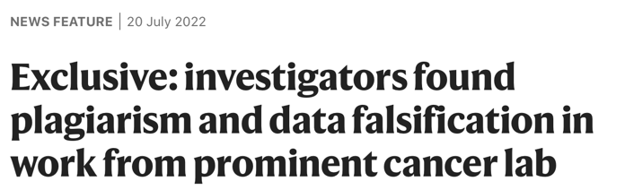
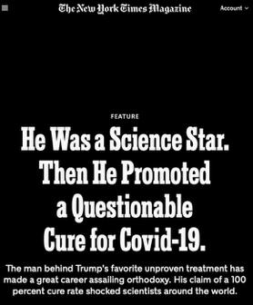
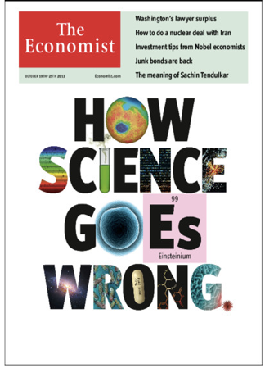
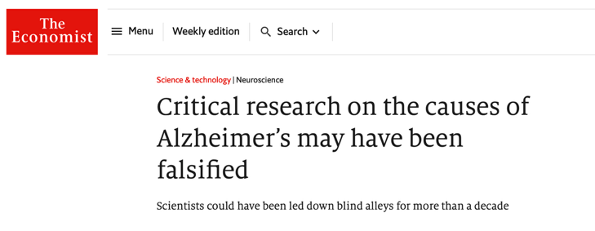
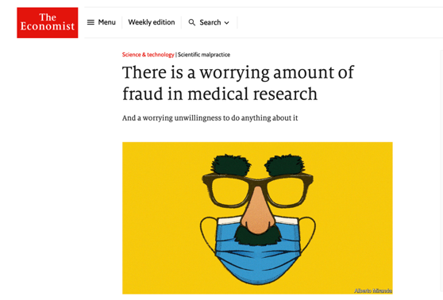
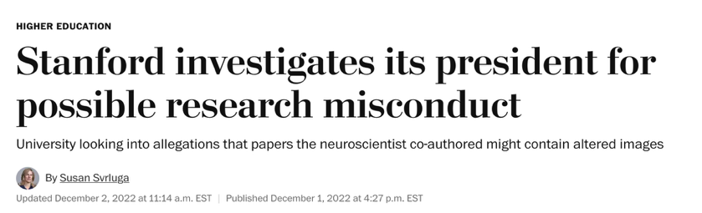

Sources (clockwise from top left, then centre): Van Noorden (2022), Nature; Reardon (2015), Nature; The Economist (2022); Svrluga (2022), The Washington Post; The Economist (2023); The Economist (2013); The New York Times (2014); Sayare (2020), The New York Times Magazine.
Notes:
The importance of research integrity becomes particularly clear when its principles are violated.
These are real headlines relating to cases of research misconduct. Cases of this kind may receive coverage in mainstream media outlets, as illustrated here by headlines from The New York Times, The Washington Post, and The Economist. Such coverage can contribute to a decline in public trust in science. E.g., The Economist is read by policy makers in Brussels.
Beyond reputational harm, research misconduct also entails societal, economic, and environmental costs. Consider, for example, the time, funding, and human resources that may be wasted when subsequent research is built on studies that were fundamentally flawed.
The resulting damage may be substantial, particularly when account is taken of the costs associated with correcting the scientific record, investigating misconduct, and rebuilding trust.
Two specific cases will be examined later in this session.
Sources:
Critical research on the causes of Alzheimer’s may have been falsified. (2022, July 23). The Economist. https://www.economist.com/science-and-technology/2022/07/23/critical-research-on-the-causes-of-alzheimers-may-have-been-falsified
How science goes wrong [Cover]. (2013, October 19). The Economist.
Reardon, S. (2015, July 1). US vaccine researcher sentenced to prison for fraud. Nature, 523(7559), 138.
Sayare, S. (2020, May 12). He was a science star. Then he promoted a questionable cure for Covid-19. The New York Times Magazine. https://www.nytimes.com/2020/05/12/magazine/didier-raoult-hydroxychloroquine.html
Stem cell research papers are retracted. (2014, July 2). The New York Times. https://www.nytimes.com/2014/07/03/business/stem-cell-research-papers-are-retracted.html
Svrluga, S. (2022, December 1). Stanford investigates its president for possible research misconduct. The Washington Post. https://www.washingtonpost.com/education/2022/12/01/stanford-university-president-research-investigation/
There is a worrying amount of fraud in medical research. (2023, February 22). The Economist. https://www.economist.com/science-and-technology/2023/02/22/there-is-a-worrying-amount-of-fraud-in-medical-research
Van Noorden, R. (2022, July 20). Exclusive: Investigators found plagiarism and data falsification in work from prominent cancer lab. Nature. https://doi.org/10.1038/d41586-022-02002-5

Slide 8
Why should we care?
What are the consequences?
Notes:
We may now turn to the question of why research integrity matters.
The following slides address this question by highlighting the consequences of research misconduct and questionable research practices, and by encouraging participants to reflect on why these issues deserve attention. The consequences are not solely academic, nor are they limited to those directly involved in misconduct.

Slide 9
Most highly cited retracted papers (Retraction Watch)
 | Title | Year of retraction | Cites before retraction | Cites after retraction
1 | Pluripotency of mesenchymal stem cells derived from adult. Nature, JUNE 20, 2002, Jiang Y et al. | 2024 | 4491 | 21
2 | Hydroxychloroquine and azithromycin as a treatment of COVID-19: results of an open-label non-randomized clinical trial. International Journal of Antimicrobial Agents. MARCH 20, 2020. Gautret P et al. | 2024 | 3177 | 12
3 | 6-month consequences of COVID-19 in patients discharged from hospital: a cohort study. Lancet, JAN 8, 2021, Huang C et al. | 2023 | 2272 | 757
4 | Primary Prevention of Cardiovascular Disease with a Mediterranean Diet. N Engl J Med, APR 4 2013, Estruch R et al. | 2018 | 1787 | 884
5 | A specific amyloid-β protein assembly in the brain impairs memory. Nature. MARCH 16, 2008, Lesné S et al. | 2024 | 2359 | 25
6 | Predictive Validity of a Medication Adherence Measure in an Outpatient Setting. The Journal of Clinical Hypertension, MAY 2, 2008, Morisky DE et al. | 2023 | 1932 | 213
7 | MicroRNA signatures of tumor-derived exosomes as diagnostic biomarkers of ovarian cancer. Gynecologic Oncology, JUNE 25, 2008, Taylor DD et al. | 2023 | 1868 | 72
8 | Ileal-lymphoid-nodular hyperplasia, non-specific colitis, and pervasive developmental disorder in children. Lancet, FEB 28 1998, Wakefield AJ et al. | 2010 | 734 | 1007
Numbers as of June 2025
Source: Retraction Watch (n.d.), Top 10 most highly cited retracted papers. Figures as of June 2025.
Notes:
Presenter note: The figures on this slide are as of June 2025. Retraction Watch updates this list regularly; the figures can be refreshed from the Retraction Watch leaderboard listed under Sources.
The aim of this slide is to make the audience think about real cases of problematic research. Whether retractions are due to misconduct or questionable research practices, they indicate that even when problems are caught, they can remain in the scientific record and propagate.
This slide presents some of the most highly cited retracted papers listed by Retraction Watch, an organisation that monitors retractions with the aim of promoting transparency and accountability in science. The list includes the year of publication, the year of retraction, and the number of citations recorded before and after retraction. To encourage discussion, participants may be asked whether they are familiar with Retraction Watch.
Many of the papers on this list were published in highly prestigious journals and were cited hundreds or even thousands of times before being retracted. One of the most widely known examples is number 8 on the list: the 1998 paper by Andrew Wakefield, which falsely suggested a link between the MMR vaccine and autism. Although the study was thoroughly discredited and subsequently retracted, it has remained highly influential and continues to be cited.
The central message of this slide is that, even after retraction, flawed research may continue to shape the scientific record. Subsequent researchers may formulate hypotheses or design studies on the basis of unreliable findings, thereby allowing flawed science to exert continuing influence.
Retraction Watch found cases of articles that were themselves retracted because they relied on previously retracted studies, creating a chain of unreliable research.
A further important point emerging from Retraction Watch’s analyses is that a substantial proportion of retractions are associated with serious misconduct, including fabrication, falsification, and plagiarism, all of which fall within the U.S. government’s definition of scientific misconduct. A further proportion involves other dishonest practices, such as false authorship, manipulated peer review, or the absence of ethics approval.
At this stage, it may be useful to note that retractions should not be understood solely in negative terms. They may also indicate that mechanisms of self-correction in research are functioning. In some cases, authors themselves request retraction after identifying honest errors and seeking to remove unreliable findings from the scientific record. Such actions deserve recognition, as retracting one’s own work is rarely straightforward.
Sources:
Brainard, J., & You, J. (2018, October 25). What a massive database of retracted papers reveals about science publishing’s ‘death penalty’. Science. https://www.science.org/content/article/what-massive-database-retracted-papers-reveals-about-science-publishing-s-death-penalty
Chawla, D. S. (2016, September 6). Cancer researcher logs 5th retraction. Retraction Watch. https://retractionwatch.com/2016/09/06/cancer-researcher-logs-5th-retraction/
Retraction Watch. (n.d.). Top 10 most highly cited retracted papers. Retrieved June 2025, from https://retractionwatch.com/the-retraction-watch-leaderboard/top-10-most-highly-cited-retracted-papers/

Slide 10

What could be the consequences for science?
Incorrect/useless results added to the scientific record
Waste of resources
Reduces public trust
Endangers public funding
Notes:
This slide may be used to invite participants to reflect on the broader consequences for science when flawed research is published, cited, retracted, and continues to be used. The possible answers may be revealed only after participants have offered their own suggestions.
A possible question is: What consequences may arise when flawed research remains part of the scientific record and continues to inform subsequent work even after retraction?
Discussion may then be directed towards the implications for trust in science, particularly in contexts of public funding. The key point is that retraction does not necessarily eliminate the effects of flawed research; such effects may continue to extend within science and beyond. For this reason, research integrity should be understood not only as an individual responsibility, but also as a matter of collective and institutional importance.

Slide 11

What could be the consequences for society?
Endangers patients and threatens people’s lives
Negative environmental impact
Impacts negatively on policies and legislation
Wastes public resources
Photo by Jacek Dylag on Unsplash
Notes:
There are also important consequences for society. This slide may be used to invite participants to reflect on the broader societal effects of flawed research. A possible question is: What further consequences might arise when unreliable research continues to circulate in the literature?
The Wakefield paper listed in the Retraction Watch list provides a well-known example. Its publication contributed to vaccine hesitancy and had consequences extending far beyond the scientific community, illustrating how flawed research can endanger public health and, in some cases, human life. The Wakefield paper played an important role in undermining confidence in the MMR vaccine, thereby contributing to vaccine hesitancy and to later outbreaks in under-vaccinated communities.
Depending on the field, unreliable research may also have negative environmental consequences. More broadly, when public policies or legislative decisions are informed by flawed evidence, they may result in ineffective or harmful measures. Debates during the COVID-19 pandemic, including those surrounding unsupported treatments such as hydroxychloroquine, provide a clear example of the policy risks associated with weak or unreliable evidence.
Research misconduct and poor research practices may also lead to the waste of public resources, raising broader questions about how funding could otherwise have been used for socially beneficial purposes, such as building a school.
Sources:
The Editors of The Lancet. (2010). Retraction—Ileal-lymphoid-nodular hyperplasia, non-specific colitis, and pervasive developmental disorder in children. The Lancet, 375(9713), 445. https://doi.org/10.1016/S0140-6736(10)60175-4
Gannon, F. (2020). Sullied. EMBO Reports, 21(9), e51371. https://doi.org/10.15252/embr.202051371
U.S. Food and Drug Administration. (2020, June 15). Coronavirus (COVID-19) update: FDA revokes emergency use authorization for chloroquine and hydroxychloroquine [Press release]. https://www.fda.gov/news-events/press-announcements/coronavirus-covid-19-update-fda-revokes-emergency-use-authorization-chloroquine-and
Vaccine fears brought measles back to New York. (2020, March 13). Nature. https://doi.org/10.1038/d41586-020-00720-2

Slide 12
Research misconduct
What is it?
Notes:
Research integrity may sometimes be understood more clearly by examining what occurs in its absence. The following slides therefore focus on research misconduct.

Slide 13
Research misconduct means
Fabrication, falsification, or plagiarism in proposing, performing, or reviewing research, or in reporting research results.
It does not include honest error or differences of opinion.
Office of Research Integrity, USA
Source: Office of Research Integrity (n.d.), U.S. Department of Health and Human Services.
Notes:
Earlier, we saw that the ORI defines research integrity in terms of honest and verifiable methods throughout the research process. In contrast, it defines research misconduct as fabrication, falsification, or plagiarism in proposing, performing, or reviewing research, or in reporting research results. Under this definition, honest error and differences of opinion do not constitute misconduct.
Source:
Office of Research Integrity. (n.d.). Definition of research misconduct. U.S. Department of Health and Human Services. https://ori.hhs.gov/definition-research-misconduct

Slide 14
Research misconduct
Falsification
Fabrication
Plagiarism
Making up data or results
Manipulating or omitting data or results
Appropriation of others’ work without giving proper credit.
Lying
Cheating
Stealing
Beware of
self-plagiarism
Office of Research Integrity, USA
Sources: Office of Research Integrity (n.d.); Roig (2015).
Notes:
This slide provides a more detailed explanation of these categories:
Fabrication refers to making up data or results
Falsification refers to manipulation or omission of data or results, thereby preventing an accurate reflection of what occurred. For example, omitting outliers without justification could constitute falsification.
Plagiarism refers to the use of another person's words, ideas, or results without appropriate acknowledgment.
For others, although not for ORI, plagiarism includes self-plagiarism: the reuse of own text, results, images or any content previously disseminated in other publications, grants, or preprints without proper citation.
This is essentially the same as lying, cheating, and stealing in research. These practices undermine trust not only in individual researchers, but also in the scientific enterprise more broadly.
Sources:
Office of Research Integrity. (n.d.). Definition of research misconduct. U.S. Department of Health and Human Services. https://ori.hhs.gov/definition-research-misconduct
Roig, M. (2015). Avoiding plagiarism, self-plagiarism, and other questionable writing practices: A guide to ethical writing. Office of Research Integrity. https://ori.hhs.gov/avoiding-plagiarism-self-plagiarism-and-other-questionable-writing-practices-guide-ethical-writing

Slide 15
Research misconduct
Questionable research practices
A wide range of practices that compromise the proper professional conduct of research or the accuracy of the research record.
Sources: Steneck (2006); ALLEA (2023).
Notes:
There is, however, a broader category of problematic practices not covered by the official ORI definition of research misconduct, often referred to as questionable research practices (QRPs). Although these may not always involve clear dishonesty, they can nonetheless undermine research integrity and compromise the quality and reliability of research. QRPs may be understood as occupying a grey area between acceptable practice and clear misconduct. Because they are often more widespread than outright misconduct, their cumulative effects may be particularly damaging.
Sources:
ALLEA. (2023). The European code of conduct for research integrity (Revised ed.). ALLEA – All European Academies. https://allea.org/portfolio-item/european-code-of-conduct-2023/
Steneck, N. H. (2006). Fostering integrity in research: Definitions, current knowledge, and future directions. Science and Engineering Ethics, 12(1), 53–74. https://doi.org/10.1007/PL00022268

Slide 16
Examples of questionable research practices
Research stage | Example
Planning | Biased study design: select methods/controls that favour wished results Too small sample size Failure to disclose conflicts of interest
Conducting | Inadequate procedures for recording or storing data; sloppiness in keeping lab notebooks Reuse of controls from past experiments Inadequate supervision of lab members
Interpreting | Inappropriate statistical methods Exclusion of outliers and negative results without justification Adding data points to a curve Unjustified or unsupported conclusions
Publishing | Statistical tricks to obtain statistical significance (P-hacking) Misattribution of authorship Unjustified modification, reuse, relabelling of images Salami slicing
Reviewing | Failure to maintain confidentiality Stealing ideas or text from a manuscript Failure to declare conflicts of interest Conscious bias toward or against colleagues, fields, methodologies
Source: Adapted from Steneck (2007).
Notes:
This slide provides examples of questionable research practices across different stages of the research process, from planning and conducting research to interpreting, publishing, and reviewing it. It illustrates that risks to research integrity are not confined to the production or publication of data alone, but may arise throughout the entire research cycle.
These examples also show that questionable practices can vary considerably in form and severity. Some reflect poor judgement, inadequate oversight, or insufficient methodological rigour, while others may involve more deliberate forms of distortion or misrepresentation. Some are due to lack of attention, sloppiness, and lack of training. Taken together, they demonstrate that threats to research integrity are often embedded in routine research practices and decision-making processes.
Some examples of the listed QRPs could be highlighted, for example:
A biased study design may arise when researchers rely on familiar methods or experimental approaches without adequately considering alternative designs that might be more appropriate to the research question. In such cases, the issue is not necessarily deliberate misconduct, but rather the uncritical selection of methods that may shape the results in a particular direction or limit the validity of the findings.
The reuse of controls from previous experiments may be problematic when those controls are presented as if they were generated specifically for the study in question, or when important differences in experimental conditions are overlooked. Because controls are intended to validate a particular experiment under its specific conditions, reusing them without clear justification can compromise the reliability and interpretability of the results.
Excluding outliers or negative results without justification can lead to a misleading presentation of the data, making the findings appear stronger or more consistent than they truly are. If data are excluded, this should be done on the basis of transparent and scientifically justified criteria.
Salami slicing means dividing the results of a single research project or dataset into several smaller publications when they could more appropriately have been presented in one more substantial paper. The problem is not simply publishing more than one paper from the same project. It becomes questionable when the slicing is unjustified and is done mainly to increase publication counts, while producing fragmented, repetitive, or potentially misleading outputs. This can distort the research record, make findings harder to interpret in context, and create a misleading impression of the amount of evidence available.
Conscious bias in reviewing occurs when the assessment of a manuscript or proposal is influenced by personal attitudes towards particular colleagues, institutions, fields, or methodologies rather than by the quality of the work itself. This undermines the fairness and objectivity of the review process.
Source:
Steneck, N. H. (2007). ORI introduction to the responsible conduct of research (Rev. ed.). Office of Research Integrity, U.S. Department of Health and Human Services. https://ori.hhs.gov/ori-introduction-responsible-conduct-research

Slide 17
Three cases of research misconduct
Notes:
Having considered the definitions and examples of research misconduct and questionable research practices, we now turn to three case studies illustrating how misconduct may arise, how it can be detected, and what consequences it may have. These cases also provide an opportunity to reflect on warning signs and on how such practices may be avoided.

Slide 18
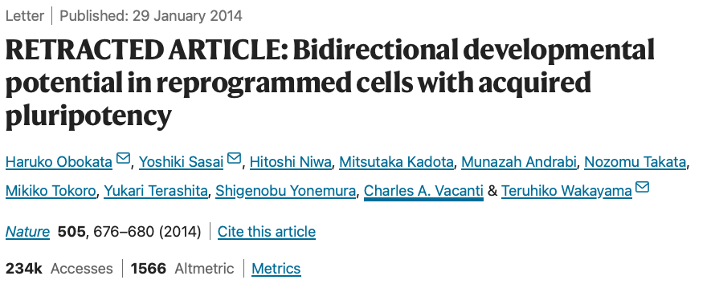
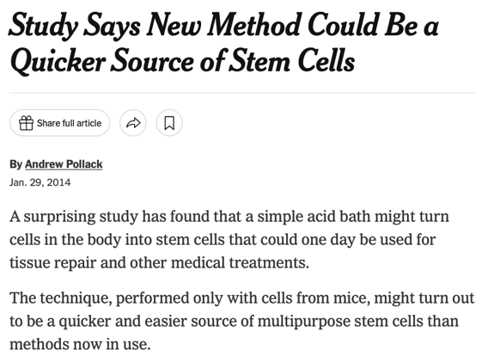
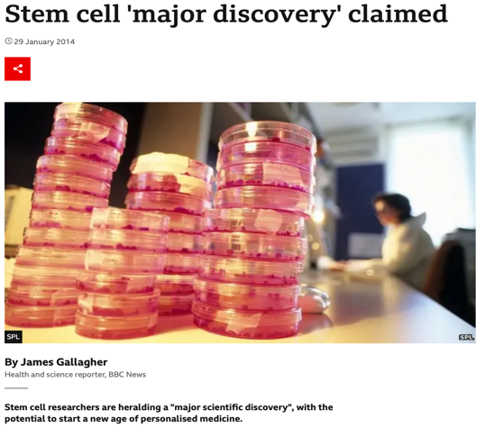

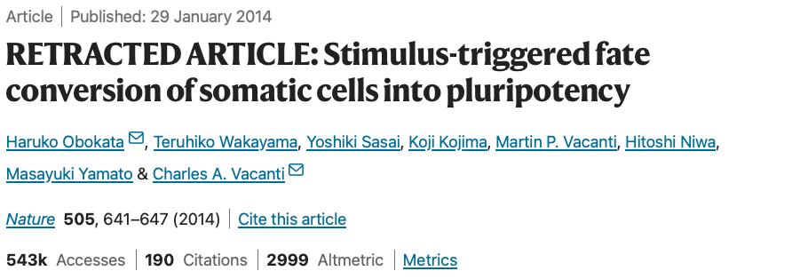
Case 1: STAP cells
Sources: Pollack (2014), The New York Times; Obokata et al. (2014), Nature; Gallagher (2014), BBC News.
Notes:
The first case concerns the field of stem cell research. In 2014, a stem cell biologist from the prestigious RIKEN institute in Japan published two groundbreaking papers in Nature, which promised to revolutionize the field of stem cell research. These papers claimed that exposing mouse somatic cells to stress, for example bathing them in acid or applying physical pressure, could reprogramme them into pluripotent-like stem cells, called STAP cells (stimulus-triggered acquisition of pluripotency).
The first author had previously conducted similar work in the U.S. and had obtained her position at RIKEN on the promise of continuing this research. The co-authors included prominent stem cell biologists, and the studies attracted intense media attention.
However, the apparent simplicity and extraordinary implications of the method soon prompted scepticism. Shortly after publication, scientists started raising concerns on PubPeer related to inconsistencies in the figures.
To encourage discussion, participants may be asked whether they are familiar with PubPeer or have ever used it to look up a paper. If necessary, a brief explanation of PubPeer may be necessary: PubPeer is an online platform for post-publication discussion of scientific papers. It began in 2012 as a virtual journal club, but has since become a space in which researchers identify potential problems in published work, sometimes contributing to subsequent corrections or retractions.
Sources:
Gallagher, J. (2014, January 29). Stem cell ‘major discovery’ claimed. BBC News. https://www.bbc.com/news/health-25917270
Obokata, H., Sasai, Y., Niwa, H., Kadota, M., Andrabi, M., Takata, N., Tokoro, M., Terashita, Y., Yonemura, S., Vacanti, C. A., & Wakayama, T. (2014). Bidirectional developmental potential in reprogrammed cells with acquired pluripotency. Nature, 505(7485), 676–680. https://doi.org/10.1038/nature12969 (Retracted)
Obokata, H., Wakayama, T., Sasai, Y., Kojima, K., Vacanti, M. P., Niwa, H., Yamato, M., & Vacanti, C. A. (2014). Stimulus-triggered fate conversion of somatic cells into pluripotency. Nature, 505(7485), 641–647. https://doi.org/10.1038/nature12968 (Retracted)
Pollack, A. (2014, January 29). Study says new method could be a quicker source of stem cells. The New York Times. https://www.nytimes.com/2014/01/30/business/study-says-new-method-could-be-a-quicker-source-of-stem-cells.html
PubPeer. (2014–). [Comments on Obokata et al. (2014), Stimulus-triggered fate conversion of somatic cells into pluripotency]. https://pubpeer.com/publications/8B755710BADFE6FB0A848A44B70F7D

Slide 19
Case 1: Data issues & investigation
Readers found:
Images wrongly labeled
Electrophoresis gel lanes switched
Images taken from her unrelated PhD thesis
Nobody could repeat the experiments
Summary of findings from RIKEN:
Data and image manipulation
Data falsification
Extreme sloppiness in record keeping
Consequences:
Found guilty of misconduct and fired
Papers retracted
Research center dismantled and institute closed
Serious personal consequences
Sources: Cyranoski (2014a, 2014b), Nature; Obokata et al. (2014), Nature (retraction note).
Notes:
The concerns raised after publication quickly developed into a formal investigation. Readers identified a number of problems, including incorrectly labelled images, switched electrophoresis gel lanes, and the reuse of images from the first author’s doctoral thesis. At the same time, other researchers were unable to reproduce the reported findings, which further intensified scrutiny.
RIKEN opened an investigation at the institute in February 2014, and by July both papers had been retracted. The investigation identified data and image manipulation, data falsification and serious deficiencies in record-keeping. The first author herself was not able to reproduce the experiments when asked.
The case ultimately had far-reaching consequences: the first author was found guilty of misconduct and dismissed, her PhD was eventually revoked, the papers were retracted, and the research centre associated with the work was dismantled. The senior authors weren’t found guilty of misconduct, but they were criticized for not supervising the first author’s work. The case also had tragic personal consequences, including the death by suicide of the supervisor.
Sources:
Cyranoski, D. (2014a, February 17). Acid-bath stem-cell study under investigation. Nature. https://doi.org/10.1038/nature.2014.14738
Cyranoski, D. (2014b, April 1). Stem-cell scientist found guilty of misconduct. Nature. https://doi.org/10.1038/nature.2014.14974
Normile, D., & Vogel, G. (2014, June 13). STAP cells succumb to pressure. Science, 344(6189), 1215–1216. https://doi.org/10.1126/science.344.6189.1215
Obokata, H., Sasai, Y., Niwa, H., Kadota, M., Andrabi, M., Takata, N., Tokoro, M., Terashita, Y., Yonemura, S., Vacanti, C. A., & Wakayama, T. (2014). Bidirectional developmental potential in reprogrammed cells with acquired pluripotency. Nature, 505(7485), 676–680. https://doi.org/10.1038/nature12969 (Retracted)
Obokata, H., Wakayama, T., Sasai, Y., Kojima, K., Vacanti, M. P., Niwa, H., Yamato, M., & Vacanti, C. A. (2014). Retraction note: Stimulus-triggered fate conversion of somatic cells into pluripotency. Nature, 511(7507), 112. https://doi.org/10.1038/nature13598
PubPeer. (2014–). [Comments on “Stimulus-triggered fate conversion of somatic cells into pluripotency”]. https://pubpeer.com/publications/8B755710BADFE6FB0A848A44B70F7D

Slide 20
Lessons from this case
Extraordinary claims need extra scrutiny.
Senior researchers are responsible for work from their lab.
Good supervision is a core part of research integrity.
Data, images and records must be checked carefully before publication.
Proper record-keeping is essential for transparency and reproducibility.
Journals must not let novelty or speed reduce scrutiny.
Notes:
This case also raises questions about the role of journals. Editors and reviewers might ideally have detected some of the problems before publication, but reviewers often say that detailed image screening is not part of their task and that such issues are hard to identify without specialised detection tools.
Some journals now employ dedicated research integrity staff. For example, since 2013, EMBO Press journals carry out systematic pre-publication image and data integrity screening, and EMBO Press has a dedicated Data Integrity Analyst role to check image-based data before papers are accepted.
Source:
Pulverer, B. (2014). EMBO Press – a new way to publish. The EMBO Journal, 33(1), 1–2. https://doi.org/10.1002/embj.201387566

Slide 21


Case 2: Neurosciences
Stanford University, USA ​
Allegations of image manipulation and duplication
20 papers flagged on PubPeer, 12 examined​, 3 retracted​
Journalism student involved​
Institutional investigation, lawyers involved​
Journals failed to correct known problems
“The unusual frequency of manipulation of research data and/or substandard scientific practices from different people, at different times, and in labs at different institutions, suggests that there may have been opportunities to improve laboratory oversight and management.”
Stanford University Scientific Panel report (2023)
Sources: Svrluga (2022), The Washington Post; Stanford University Board of Trustees (2023), Scientific panel final report.
Notes:
This case concerns a series of problems across papers published by a neuroscience research group over many years, rather than a single paper or experiment.
It involved a prominent neurosciences researcher at Stanford University, USA.
Sources:
Baker, T. (2022, November 29). Stanford president’s research under investigation for scientific misconduct, University admits ‘mistakes’. The Stanford Daily. https://stanforddaily.com/2022/11/29/stanford-presidents-research-under-investigation-for-scientific-misconduct-university-admits-mistakes/
Kozlov, M. (2023, July 27). What the Stanford president’s resignation can teach lab leaders. Nature. https://doi.org/10.1038/d41586-023-02438-3
Stanford University Board of Trustees. (2023). Scientific panel final report [Investigation report]. https://boardoftrustees.stanford.edu/sites/g/files/sbiybj31576/files/media/file/scientific-panel-final-report.pdf
Svrluga, S. (2022, December 1). Stanford investigates its president for possible research misconduct. The Washington Post. https://www.washingtonpost.com/education/2022/12/01/stanford-university-president-research-investigation/

Slide 22
Case 2: Issues & investigation
Problems found:
Images altered inappropriately: splice sites and duplicated bands in Western blots
Errors and inconsistencies across multiple papers
Investigation outcomes:
Did not commit misconduct himself
Failed to ensure that known errors were corrected
Research process lacked sufficient rigor
Poor lab oversight and management practices identified
Consequences:
Author resigned as Stanford President
3 papers retracted so far
Further corrections issued or pursued
Sources: Stanford University Board of Trustees (2023); Baker (2022), The Stanford Daily; Kozlov (2023), Nature.
Notes:
Concerns were first raised on PubPeer in 2015, including papers in Science and Cell, with allegations of image manipulation and duplication.
The case gained wider attention when a student journalist at The Stanford Daily investigated the allegations and consulted forensic image analysts. Former Genentech employees also raised concerns about results in a 2009 Nature paper, which contributed to Stanford opening a formal investigation. The investigation examined 12 papers and concluded that the researcher did not personally commit misconduct, but that he failed to correct known problems and that his lab oversight and research practices lacked sufficient rigor.
The consequences were: he resigned as Stanford president, three papers were retracted, and further corrections followed.
The case also raised questions about the responsibilities of journal editors. The investigated author had previously contacted the journals when concerns were raised, but Cell issued no corrections and Science approved corrections that were never posted. The investigation noted that he did not follow up to clarify why the journals had not acted.
Sources:
Baker, T. (2022, November 29). Stanford president’s research under investigation for scientific misconduct, University admits ‘mistakes’. The Stanford Daily. https://stanforddaily.com/2022/11/29/stanford-presidents-research-under-investigation-for-scientific-misconduct-university-admits-mistakes/
Kozlov, M. (2023, July 27). What the Stanford president’s resignation can teach lab leaders. Nature. https://doi.org/10.1038/d41586-023-02438-3
Stanford University Board of Trustees. (2023). Scientific panel final report [Investigation report]. https://boardoftrustees.stanford.edu/sites/g/files/sbiybj31576/files/media/file/scientific-panel-final-report.pdf

Slide 23
Lessons from this case
Lab heads must supervise research actively.
Senior authors are accountable for all work published from their lab.
Known problems must be followed through until corrected.
Poor oversight can amount to serious research failure.
Journals must respond promptly to credible concerns.
Research integrity depends on transparency and correction.
Notes:
Sources:
Kozlov, M. (2023, July 27). What the Stanford president’s resignation can teach lab leaders. Nature. https://doi.org/10.1038/d41586-023-02438-3
Stanford University Board of Trustees. (2023). Scientific panel final report [Investigation report]. https://boardoftrustees.stanford.edu/sites/g/files/sbiybj31576/files/media/file/scientific-panel-final-report.pdf

Slide 24
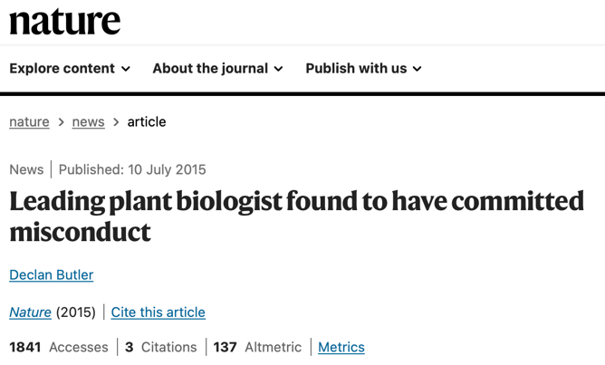
Case 3: Plant sciences
Well-respected plant scientist, known for his influential work on RNA interference
Received numerous awards and prizes
2014: PubPeer comments started to appear
Source: Butler (2015), Nature.
Notes:
This case concerns a renowned plant biologist known for influential work on RNA interference.
He was highly respected in his field and received many distinctions, including the EMBO Gold Medal. He started to be successful very early. At the time this case became public, he had two labs, one in France funded by CNRS and one in Switzerland at ETH Zurich. He was also elected an EMBO Member and had previously been part of the EMBO Young Investigator Programme.
Sources:
Butler, D. (2015, July 10). Leading plant biologist found to have committed misconduct. Nature. https://doi.org/10.1038/nature.2015.17958
Dunoyer, P., Schott, G., Himber, C., Meyer, D., Takeda, A., Carrington, J. C., & Voinnet, O. (2010). Small RNA duplexes function as mobile silencing signals between plant cells. Science, 328(5980), 912–916. https://doi.org/10.1126/science.1185880 (Retracted)
PubPeer. (2014–). [Comments on “Small RNA duplexes function as mobile silencing signals between plant cells”]. https://pubpeer.com/publications/99D465D980ABB74F58439A9CD16219
PubPeer. (2014–). [Comments on “Viral pathogenicity determinants are suppressors of transgene silencing in Nicotiana benthamiana”]. https://pubpeer.com/publications/C212754B71B23CD2137797D265935D
Schneider, L. (2015, March 24). Too much to be nothing? Lab Times. http://www.labtimes.org/editorial/e_594.lasso

Slide 25
Case 3: Data issues & investigations
Summary of issues:
Duplicated controls between figures and papers
Misrepresentation of Western blots
Inaccurate labelling
Unjustified beautifications of figures
Conclusion of investigations:
CNRS: misconduct, but not serious | ETH: Not misconduct: “conducted properly” but “published incorrectly”.
Breached duty of care of lab members
Post-doc found guilty in later investigation
Consequences
8 retractions and more than 20 corrections
Funding ban
Labs closed temporarily
EMBO Gold Medal revoked
Sources: ETH Zurich (2015); CNRS (2018); Butler (2015), Nature; Palus (2016), Retraction Watch.
Notes:
In 2014, comments posted on PubPeer began to raise concerns about figures in several of his papers. As the scrutiny widened, it emerged that problematic practices went back as far as his PhD work. These included duplicated Western blot panels, reused controls, inaccurate labelling, manipulated or “beautified” figures, and the reuse of the same images in different papers.
One striking aspect of this case is that the main scientific ideas were solid and still stand, but the data had been manipulated to make the findings appear more convincing. Over time, such practices also affected work produced by previous members of his laboratory, showing how poor research habits can be passed on within a lab and how important lab-level standards are for research integrity.
Investigations by ETH and CNRS reached somewhat different conclusions. The CNRS investigation found misconduct, though not serious misconduct, while the ETH investigation concluded that there was not enough evidence to prove deliberate fraud. However, ETH found that he had breached his responsibilities as a supervisor and lab leader. He had failed to ensure adequate oversight, and the investigation criticised the lab culture, describing an environment marked by stress, competition and insufficient discussion of results, with lab members reportedly sharing data only every six months. A later investigation also found a postdoctoral researcher in the lab guilty of misconduct.
The consequences were substantial. Eight papers were retracted and more than twenty were corrected. He was temporarily banned from applying for funding, his laboratories were closed for a period, and the EMBO Gold Medal was revoked.
The case also showed that problems extended beyond one individual, as concerns were identified in papers authored by members of his lab as well. It is therefore a strong example of how leadership, supervision and lab culture can shape research practices across an entire group.
Sources:
Butler, D. (2015, July 10). Leading plant biologist found to have committed misconduct. Nature. https://doi.org/10.1038/nature.2015.17958
CNRS. (2018). [Press release on the outcome of the investigation concerning O. Voinnet and P. Dunoyer]. https://www.cnrs.fr/sites/default/files/press_info/2018-12/cpvoinnetdunoyer2018en.pdf
ETH Zurich. (2015, July 10). Conducted properly – published incorrectly [News release]. https://ethz.ch/en/news-and-events/eth-news/news/2015/07/investigation-result-voinnet.html
Palus, S. (2016, January 28). EMBO takes back Voinnet’s award, investigates other awardee who just lost a Nature Genetics paper. Retraction Watch. https://retractionwatch.com/2016/01/28/embo-takes-back-voinnets-award-investigates-other-awardee-who-just-lost-a-nature-genetics-paper/
PubPeer. (2014–). [Comments on “Identification, subcellular localization and some properties of a cysteine-rich suppressor of gene silencing encoded by peanut clump virus”]. https://pubpeer.com/publications/7E72477BFA031E54D5D452B7E0BF6D
PubPeer. (2014–). [Comments on “Multivesicular bodies associate with components of miRNA effector complexes and modulate miRNA activity”]. https://pubpeer.com/publications/358DABD0BE713B03950C76D7652140
PubPeer. (2014–). [Comments on “Small RNA duplexes function as mobile silencing signals between plant cells”]. https://pubpeer.com/publications/99D465D980ABB74F58439A9CD16219
PubPeer. (2014–). [Comments on “Viral pathogenicity determinants are suppressors of transgene silencing in Nicotiana benthamiana”]. https://pubpeer.com/publications/C212754B71B23CD2137797D265935D

Slide 26
Lessons from this case
Scientific prestige does not protect against poor practice.
Senior researchers set the tone for the whole lab: role models matter.
Poor practices can be passed from supervisors to trainees and become normalised.
Raw data, controls and images must be checked carefully.
A highly competitive or high-pressure lab culture can increase the risk of misconduct.
Misconduct can damage entire labs and fields.
Corrections, retractions and sanctions may come years later, but the damage to trust can be long-lasting.
Notes:
Sources:
Butler, D. (2015, July 10). Leading plant biologist found to have committed misconduct. Nature. https://doi.org/10.1038/nature.2015.17958
CNRS. (2018). [Press release on the outcome of the investigation concerning O. Voinnet and P. Dunoyer]. https://www.cnrs.fr/sites/default/files/press_info/2018-12/cpvoinnetdunoyer2018en.pdf
ETH Zurich. (2015, July 10). Conducted properly – published incorrectly [News release]. https://ethz.ch/en/news-and-events/eth-news/news/2015/07/investigation-result-voinnet.html

Slide 27
How common is misconduct?
Notes:
This is one of the most common questions in discussions about research integrity, so it is useful to look at what the evidence can and cannot tell us.

Slide 28
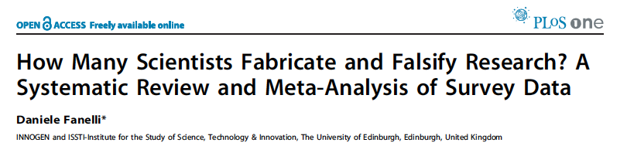
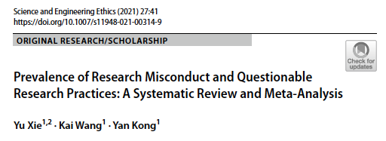
How often does misconduct occur?
Sources: Fanelli (2009), PLoS ONE; Xie et al. (2021), Science and Engineering Ethics.
Notes:
Given how serious these consequences can be, an obvious question is: how often do research misconduct and questionable research practices actually occur?
The honest answer is that we do not know exactly. Proven cases represent only the cases that are detected, investigated and reported, but not all cases are reported or systematically recorded. In the United States, the NIH publishes annual information on concluded misconduct cases, but many other institutions do not maintain or share comparable data. As a result, it is difficult to determine the true frequency of misconduct.
However, two meta-analyses provide useful insight.
The first is by Daniele Fanelli, published in 2009. He reviewed 18 studies that surveyed researchers, primarily from high-income countries such as the United States, the United Kingdom and Australia. These studies asked scientists whether they had committed, or observed, misconduct or questionable research practices.
In 2021, Xie et al. did a meta-analysis of 42 studies and offered a broader global perspective, including data from low- and middle-income countries such as India and Nigeria, as well as more recent studies.
Both meta-analyses rely on self-reported data, so they have important limitations. Even so, their findings on research misconduct were surprisingly consistent, which suggests some stability in the overall pattern.
Sources:
Fanelli, D. (2009). How many scientists fabricate and falsify research? A systematic review and meta-analysis of survey data. PLoS ONE, 4(5), e5738. https://doi.org/10.1371/journal.pone.0005738
Xie, Y., Wang, K., & Kong, Y. (2021). Prevalence of research misconduct and questionable research practices: A systematic review and meta-analysis. Science and Engineering Ethics, 27(4), 41. https://doi.org/10.1007/s11948-021-00314-9

Slide 29
How common are misconduct and questionable research practices ?​
Research misconduct (%)
 | Self | Others
Fanelli (2009) | 1.97 | 14.12
Xie et al. (2021) | 2.9 | 15.5
Questionable research practices (%)​
 | Self | Others
Fanelli (2009) | 9.54 | 28.53
Xie et al. (2021) | 12.5 | 39.7
Sources: Fanelli (2009); Xie et al. (2021). Percentages are based on two meta-analyses of survey studies; definitions and methods differ slightly across studies.
Notes:
Across both studies, only a small proportion of surveyed researchers, roughly 2-3%, admitted to having committed research misconduct themselves. However, around 14-16% said they had observed or knew of someone who had engaged in misconduct. This suggests that concerns about misconduct extend beyond the relatively small number of self-reported cases and may contribute to a degree of mistrust within the research community.
The numbers are much higher for questionable research practices (QRPs). In Fanelli’s 2009 meta-analysis, self-reported QRP rates varied widely, with an unweighted mean of about 9.5% and upper estimates of 33.7%, while reports about colleagues reached as high as 72%. Xie et al. (2021) estimated that 12.5% of researchers had engaged in at least one QRP themselves, and 39.7% were aware of at least one QRP by others.
The exact percentages are not perfectly comparable because the two meta-analyses used slightly different definitions and methods. But they point to the same conclusion: serious misconduct is reported by a small minority, whereas questionable research practices are much more common.
The overall conclusion is clear: while confirmed or self-reported misconduct appears to be relatively rare, questionable research practices are far more common.
Sources:
Fanelli, D. (2009). How many scientists fabricate and falsify research? A systematic review and meta-analysis of survey data. PLoS ONE, 4(5), e5738. https://doi.org/10.1371/journal.pone.0005738
Xie, Y., Wang, K., & Kong, Y. (2021). Prevalence of research misconduct and questionable research practices: A systematic review and meta-analysis. Science and Engineering Ethics, 27(4), 41. https://doi.org/10.1007/s11948-021-00314-9

Slide 30

Image aberrations found in EMBO Press journals
EMBO classification | Image Manipulation | Action | %*
I | cosmetic & mistakes; source data & convincing author explanation | revision, no report | 10
II | beautification & undeclared manipulation that changes conclusions; source data or new data | may revise, may reject, may report | 0.4
III | undeclared manipulation with obfuscation & intent; no or misleading explanation; no or fake source data | reject and report | <0.2
Total |  |  | 10.5
EMBO Press publication screening 2021-2023
* Share of manuscripts accepted for publication, EMBO Press screening 2021–2023. Source: Classification adapted from Pulverer (2015).
Notes:
Another way to estimate the frequency of misconduct and the use of questionable research practices comes from a journal perspective.
One example comes from EMBO Press, which carries out routine image checks on manuscripts accepted for publication. This table explains how EMBO Press journals classify image aberrations. It is also a useful framework for thinking about intentionality and impact.
Overall, EMBO Press journals find image-related problems in about 10.5% of manuscripts accepted for publication.
Level 1: These are typically relatively minor issues such as poor cropping or inadequate image annotation. They are the most common problems identified in EMBO Press journals.
Level 2: These are borderline cases in which intent is unclear, but the problems affect data interpretation. Depending on the context, they could be either QRPs or research misconduct. They are found in 0.4% of accepted manuscripts at EMBO Press.
Level 3: These represent clear research misconduct, such as deliberate image duplication, manipulation, or falsification. They are the least frequent type of image aberration.
This suggests that while clear research misconduct is relatively uncommon, it does occur, alongside a broader range of other problematic practices.
Note: The percentages on this slide are based on EMBO Press screening data from 2021–2023 and have therefore been updated since Pulverer (2015).
Source:
Pulverer, B. (2015). When things go wrong: Correcting the scientific record. The EMBO Journal, 34(20), 2483–2485. https://doi.org/10.15252/embj.201570080

Slide 31
A thin line
Sloppiness
Mistakes
Questionable practices
Poor oversight
Misconduct
Notes:
From the previous slides: We often focus on striking cases of misconduct, but the bigger problem may be the much more common issues: sloppiness, mistakes and questionable research practices. These are less dramatic, but they can still damage research quality in major ways.
And in practice, the line is often not clear. It is not always easy to tell whether a problem reflects carelessness, poor oversight or deliberate misconduct. But the consequences can be very similar: unreliable results, wasted resources, and in some fields even harm to patients or the public.
So the question is not only how to deal with misconduct once it happens, but how to build a research environment in which good practice is the default.

Slide 32
Who is responsible?
Notes:
Who is responsible for building an environment where responsible research is the norm?

Slide 33
Responsibility is shared across the system
Research system:
funders, publishers,
academies, professional societies
Institute
Lab
Individual
researcher
Notes:
At the end of the day, individual researchers are ultimately responsible for their own actions and for the choices they make in their daily research practice. Research integrity is shaped by these everyday decisions: how we collect data, how honestly we report results, and how we respond when we notice problems.
But individual responsibility alone is not enough. Those choices are also shaped by the environment in which researchers work.
But responsibility does not stop with the individual researcher. Individual researchers make daily choices, but those choices are shaped by the lab they work in, the policies and culture of their institution, and the wider research system, including funders, publishers, academies and professional societies.
If we want responsible researchh to be the norm, all of these levels have to work together.
Sources:
ALLEA. (2023). The European code of conduct for research integrity (Revised ed.). ALLEA – All European Academies. https://allea.org/portfolio-item/european-code-of-conduct-2023/

Slide 34
your responsibilities
Supervisors
PIs
Readers
Post-docs
Authors
Data curators
Reviewers
Heads of depts.
Statisticians
Lab managers
Editors
Heads of institutes
PhD students
Master students
Notes:
As researchers, you (we) take on many different roles: student, postdoc, supervisor, author, reviewer, editor, or evaluator. Each of these roles brings particular responsibilities. Some overlap, but some are specific to that role. Research integrity means also recognising those responsibilities and continuing to act on them as our roles change over time.
Animation in order: PIs, post-docs, PhD students, statisticians, heads of departments, master students, lab managers, heads of institutes, authors, readers, reviewers, editors, supervisors, data curators

Slide 35
our responsibilities
Scientific organizations
Scientific academies
Funders
Publishers
Universities
Research organizations
Policy makers
Notes:
But responsible are also organizations such as universities, research institutes, funders, publishers, scientific academies, scientific organizations and policy makers. All of these actors shape the conditions in which research is carried out, and all have a role in making responsible research the norm.

Slide 36
Systemic factors
Research assessment based largely on quantitative measures
Publish-or-perish culture
Increasingly competition for fellowships, grants and jobs
Precarious career structures
Notes:
Many research practices are shaped also by systemic pressures. Research assessment, publish-or-perish culture, competition for grants and jobs, and insecure career structures can all influence how researchers work and what they prioritise.
Publish-or-perish culture: a research culture in which career success depends heavily on producing a constant stream of publications.

Slide 37
Research assessment
How research is assessed
How research is done
What researchers do
How they do it
What they prioritise
Incentives and “rules of the game”
What is assessed
How quality is measured
Career advancement
Sources: DORA (2012); CoARA (2022)
Notes:
This is an example of a systemic factor influencing researchers’ practice: research assessment.
The way research and researchers are assessed has a strong influence on researcher behaviour. What is evaluated, and how quality is measured, affects what researchers do, how they work, and what they prioritise.
Assessment systems create both conscious and unconscious incentives. Researchers quickly learn what counts in evaluations, and they adapt to those expectations in order to succeed. In that sense, they learn the “rules of the game”.
A well-known example is the use of impact factor and other journal-based metrics in hiring, promotion, funding and prizes. When these measures carry a lot of weight, they can shape publication strategies and influence research behaviour. This is why research assessment is so important: it does not simply measure performance, it also helps to shape it.
Sources:
CoARA. (2022). Agreement on reforming research assessment. https://coara.org/agreement/the-agreement-full-text/
DORA. (2012). San Francisco declaration on research assessment. https://sfdora.org/read/

Slide 38
Publish-or-perish culture
Academic careers depend heavily on publications
Prestige of journals is often treated as a sign of quality
Publications shape access to funding, jobs, promotion and recognition
Result: This creates constant pressure to publish
Notes:
This slide is about the practical effect of those assessment systems. In academic research, publications are still the main currency of career success. They shape access to funding, jobs, promotions, awards and professional recognition.
Because journal prestige is often used as a shortcut for quality, researchers are under constant pressure not just to publish, but to publish in the “right” journals. That is what we mean by a publish-or-perish culture.
This pressure does not automatically lead to misconduct, but it can strongly shape research behaviour and priorities.

Slide 39
AI risks to research integrity
Generative AI puts trust under pressure
In research
AI-generated hypothesis, analysis or conclusions used without human verification
Hallucinated facts
Fabrication: AI-generated data or images used without validation
Falsification: AI-assisted manipulation of images and data
Confidential data, e.g. patients’ data, uploaded to AI tools without confidentiality guarantees
Over-reliance on AI weakens researchers' skills and judgement
In publishing
Fake papers produced at industrial scale by paper mills
AI-generated data or images presented as real experiment results
AI-generated work presented as the author’s own work
Hallucinated references
AI-assisted plagiarism: paraphrasing that evades plagiarism checks
Peer review outsourced to AI: generic reviews, breach of confidentiality
In funding
AI-generated research ideas presented as the applicant’s own
Fabricated preliminary data, references or claims in proposals
AI-generated reviews declared as the reviewer’s own
Confidential proposals fed into AI tools without confidentiality guarantees
Funding decisions delegated to opaque, potentially biased AI-based scores
Not all new in kind: AI makes “traditional” misconduct cheaper, faster and harder to detect, while human responsibility remains unchanged.
Sources: UK Research Integrity Office (2025); Blau et al. (2024); European Commission (2026); The Royal Society (2024); Van Noorden (2023), Nature.
Notes:
The next two slides briefly address generative AI, the risks it poses to research integrity and ways to mitigate them.
AI promises to have a transformative impact on virtually every aspect of the research process, from data analysis, hypothesis generation and experimental design to management and dissemination of scientific knowledge and research funding. If used responsibly, it offers huge opportunities to accelerate the efficiency, accuracy, and creativity of scientists. It is accelerating text-based tasks such as writing, conducting literature reviews, or producing summaries. AI is used as an assistant or support to scientists to perform tasks at a pace and scale previously unthinkable.
But AI use also poses some risks, if it is not used responsibly.
This slide shows examples of misuse of AI in how research is conducted (box 1), how it is communicated (box 2), and in the grant-making process (box 3).
Most of these risks are not new, but AI makes the situation worse as misconduct becomes cheaper, faster and harder to detect, which puts trust in research under growing pressure. It is important to stress that the responsibility for all this remains human, as before.
Sources:
Blau, W., Cerf, V. G., Enriquez, J., Francisco, J. S., Gasser, U., Gray, M. L., Greaves, M., Grosz, B. J., Jamieson, K. H., Haug, G. H., Hennessy, J. L., Horvitz, E., Kaiser, D. I., London, A. J., Lovell-Badge, R., McNutt, M. K., Minow, M., Mitchell, T. M., Ness, S., . . . Witherell, M. (2024). Protecting scientific integrity in an age of generative AI. Proceedings of the National Academy of Sciences, 121(22), e2407886121. https://doi.org/10.1073/pnas.2407886121
European Commission, ERA Forum. (2026). Living guidelines on the responsible use of generative AI in research [ERA Forum stakeholders’ document]. https://research-and-innovation.ec.europa.eu/document/2b6cf7e5-36ac-41cb-aab5-0d32050143dc_en
The Royal Society. (2024). Science in the age of AI: How artificial intelligence is changing the nature and method of scientific research. https://royalsociety.org/-/media/policy/projects/science-in-the-age-of-ai/science-in-the-age-of-ai-report.pdf
UK Research Integrity Office. (2025). Embracing AI with integrity. https://ukrio.org/wp-content/uploads/Embracing-AI-with-integrity.pdf
Van Noorden, R. (2023). How big is science’s fake-paper problem? Nature, 623(7987), 466–467. https://doi.org/10.1038/d41586-023-03464-x

Slide 40
AI and research integrity: What can researchers do?
Researchers can strengthen the trust system, for example:
Remain responsible for scientific output: verify all AI output, including references, for errors, bias, hallucinations, and inaccuracies
Disclose and attribute AI use transparently
Protect privacy, confidentiality and IP: no unpublished or sensitive work or personal data in AI tools without confidentiality guarantees
Practice open science: share source data, metadata and methods
Cite others’ work properly
Refrain from substantial use of AI in peer review and evaluation of research proposals
Sources: European Commission (2026); UK Research Integrity Office (2025); Blau et al. (2024); The Royal Society (2024).
Notes:
This slide lists examples of how researchers can safeguard trust in research while using AI tools.
You can also engage your audience by asking which aspects of AI use in their work they find more problematic.
Sources:
Blau, W., Cerf, V. G., Enriquez, J., Francisco, J. S., Gasser, U., Gray, M. L., Greaves, M., Grosz, B. J., Jamieson, K. H., Haug, G. H., Hennessy, J. L., Horvitz, E., Kaiser, D. I., London, A. J., Lovell-Badge, R., McNutt, M. K., Minow, M., Mitchell, T. M., Ness, S., . . . Witherell, M. (2024). Protecting scientific integrity in an age of generative AI. Proceedings of the National Academy of Sciences, 121(22), e2407886121. https://doi.org/10.1073/pnas.2407886121
European Commission, ERA Forum. (2026). Living guidelines on the responsible use of generative AI in research [ERA Forum stakeholders’ document]. https://research-and-innovation.ec.europa.eu/document/2b6cf7e5-36ac-41cb-aab5-0d32050143dc_en
The Royal Society. (2024). Science in the age of AI: How artificial intelligence is changing the nature and method of scientific research. https://royalsociety.org/-/media/policy/projects/science-in-the-age-of-ai/science-in-the-age-of-ai-report.pdf
UK Research Integrity Office. (2025). Embracing AI with integrity. https://ukrio.org/wp-content/uploads/Embracing-AI-with-integrity.pdf

Slide 41
What can be done?
Notes:
If we now move from the problems to the solutions, we can look at the different actors in the research ecosystem and ask what each of them can do to promote integrity and help prevent misconduct.

Slide 42
Funders, academies, publishers
Funders
Reward open science
Use broader assessment criteria instead of journal prestige alone
Reward good supervision, mentoring, and teamwork
Make research integrity and research culture part of grant conditions
Provide funding for training, data stewardship and research culture improvement
Academies and societies
Develop standards
and guidance
Provide training
Promote responsible norms
Align prizes and recognition with integrity
Publishers
Screen for integrity problems
Require better reporting and data transparency
Train editors and reviewers
Correct the record transparently
Sources: DORA (2012); CoARA (2022); Wellcome (n.d.); COPE (n.d.); EMBO Press (n.d.).
Notes:
Funders can influence behaviour through the way they assess researchers and proposals, the conditions they attach to grants, and the practices they choose to reward. For example, they can require data management and sharing plans, support open science, and move away from narrow metric-based evaluation.
Academies and scientific societies can help define good practice in their fields. They can develop standards and guidance, provide training, and use prizes, honours and professional recognition to reinforce norms of responsible conduct.
Publishers also play a crucial role. They can improve quality control through reporting standards, submission checklists, image and data screening, and clear correction and retraction procedures. Together, these actors help create the conditions in which responsible research can become the norm rather than the exception.
Sources:
CoARA. (2022). Agreement on reforming research assessment. https://coara.org/agreement/the-agreement-full-text/
Committee on Publication Ethics. (n.d.). Code of conduct. https://publicationethics.org/membership/code-of-conduct
DORA. (2012). San Francisco declaration on research assessment. https://sfdora.org/read/
EMBO Press. (n.d.). Editorial policies. https://link.springer.com/partners/embo-press/editorial-policies
Wellcome. (n.d.). Responsible conduct of research [Grant conditions and policy]. https://wellcome.org/research-funding/guidance/policies-grant-conditions/responsible-conduct-research

Slide 43
Research performing organisations
Adopt and enforce codes and guidelines
Describe best practices for data management
Provide infrastructure for data management and sharing
Establish clear authorship policies
Train lab leaders training in supervision and mentorship
Train students, faculty and technical staff in research integrity
Provide training in statistics and technical skills
Do you have access to such training or support at your institute?
Notes:
Now let’s look at institutions. They are often the closest point of contact for researchers.
Research-performing organisations, such as universities and research institutes, have a central role in shaping everyday research practice. They are responsible not only for setting formal rules, but also for creating the conditions that allow researchers to follow them.
That includes adopting and enforcing clear codes and guidelines, defining good data management practices, and providing the infrastructure needed for secure data storage and sharing.
Institutions also need clear authorship policies, because many disputes and questionable practices arise around credit and responsibility.
Just as importantly, institutions should invest in people. That means training students, faculty and technical staff in research integrity, providing stronger support in statistics and technical methods, and preparing lab leaders for their roles as mentors and supervisors. If institutions want responsible research to be the norm, they need to support it in practice, not only endorse it in principle.
Here, you could invite the audience to relate these findings to the reality of their own institute: Do you have access to such training or support at your institute?

Slide 44
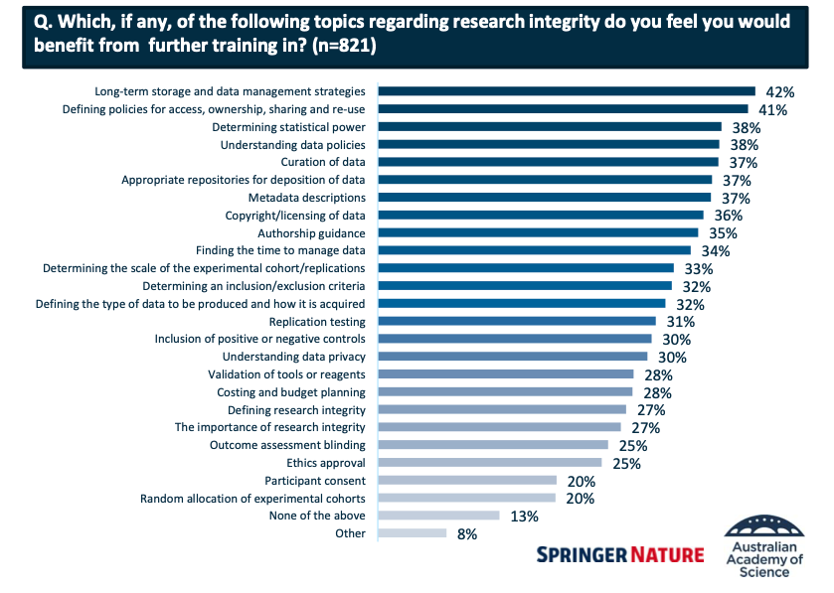
Survey on training
The importance of data in responsible research
Long-term storage and data management strategies
Defining policies for access, ownership sharing and re-use
Determining statistical power
Understanding data policies
Curation of data
Appropriate repositories for deposition of data
Metadata descriptions
Copyright/licensing of data
Authorship guidance
….
Source: Springer Nature & Australian Academy of Science (2022).
Notes:
Institutions have a responsibility to provide training and support. But what kind of training do researchers actually say they need?
In 2022, Springer Nature and the Australian Academy of Science conducted a survey on researchers’ perceived access to training in Australia, focusing mainly on early- and mid-career researchers. They asked what kinds of training researchers felt they needed in order to work more effectively.
Survey data show that researchers want practical support in many areas related to responsible research. These needs go well beyond general statements about integrity and include concrete skills such as data management, long-term storage, metadata, repository use, authorship, licensing, and understanding data policies.
This is important because many problems in research do not arise only from bad intentions, but also from a lack of knowledge, guidance or technical support. Training therefore needs to be practical, specific and relevant to researchers’ day-to-day work.
In other words, if we want responsible research to become the norm, we need to equip researchers with the skills and support to do it well.
Again, here, you could invite the audience to relate these findings to the reality of their own institute: What do you think? Do these findings resonate with your experience? Is there any other kind of training you feel you need?
Source:
Springer Nature & Australian Academy of Science. (2022). Research integrity – A survey looking at needs and provision of training in Australian institutions [Presentation]. figshare. https://doi.org/10.6084/m9.figshare.19773298

Slide 45
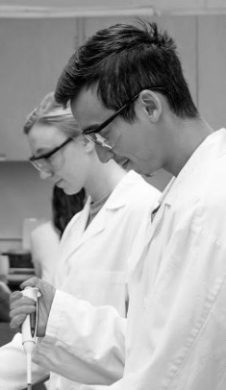
Workplace climate
Perceptions of the work environment
Problematic practices are more likely when policies on good research practices are weak or unclear
Poor workplace climate and undesirable research practices are correlated
- Survey of Organizational Research Climate (SORC)
Sources: Survey of Organizational Research Climate (SORC): Martinson et al. (2013); Crain et al. (2013).
Notes:
Another important part of the institutional environment is research climate, in other words, how researchers experience their workplace in practice. This includes whether expectations are clear, whether people feel supported, whether concerns can be raised safely, and whether responsible conduct is genuinely valued.
Research using the SORC survey showed that poor institutional climate is linked to more undesirable research practices. When support is weak, guidance is lacking, collaboration is poor, or policies are unclear, questionable practices become more likely. This again shows that research integrity depends not only on individuals, but also on the environment in which they work.
Sources:
Crain, A. L., Martinson, B. C., & Thrush, C. R. (2013). Relationships between the Survey of Organizational Research Climate (SORC) and self-reported research practices. Science and Engineering Ethics, 19(3), 835–850. https://doi.org/10.1007/s11948-012-9409-0
Martinson, B. C., Thrush, C. R., & Crain, A. L. (2013). Development and validation of the Survey of Organizational Research Climate (SORC). Science and Engineering Ethics, 19(3), 813–834. https://doi.org/10.1007/s11948-012-9410-7
Online Ethics Center. (n.d.). Survey of Organizational Research Climate (SOuRCe). https://onlineethics.org/cases/evaluation-tools/survey-organizational-research-climate-source
Redman, B. K., & Caplan, A. L. (2017). Improving research misconduct policies. EMBO Reports, 18(4), 511–514. https://doi.org/10.15252/embr.201744110

Slide 46
Lab leaders
Follows codes and guidelines
Demonstrate best practices
Foster openness about mistakes
Use mistakes as teaching and learning opportunities
Encourage discussion of dilemmas
Provide guidance and training to lab members
Set clear expectations
Maintain an open-door culture
Sources: Pizzolato & Dierickx (2023)
Notes:
If research climate matters, then we also need to look at the people who shape that climate most directly in daily research practice: lab leaders.
Mentors and lab leaders play a crucial role in shaping researcher behaviour. They act as role models, and their attitudes toward integrity have a huge influence, especially on early-career researchers.
This means that institutions should not assume that good supervision happens automatically. They need to train and support supervisors in how to communicate, model and reinforce responsible research practices. Mentors also need to understand that their own behaviour can directly shape the behaviour of their trainees.
A 2023 review by Pizzolato and Dierickx found that mentors have a major influence on how young researchers adopt standards of research integrity, and that the mentor’s example is often more powerful than formal rules or policies.
If you have an audience of lab leaders or senior post-docs, you could involve them by asking: Do you know any codes and guidelines from your institution? If so, have you discussed them with your lab members?
Sources:
Pizzolato, D., & Dierickx, K. (2023). The mentor’s role in fostering research integrity standards among new generations of researchers: A review of empirical studies. Science and Engineering Ethics, 29(3), 19. https://doi.org/10.1007/s11948-023-00439-z

Slide 47
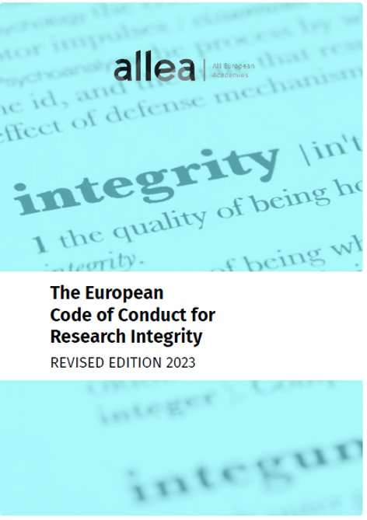
Individual researchers
Read the relevant codes and guidelines
Identify where to ask for advice
Speak up when they see problems
Ask for guidance when unsure
Ask for training when needed
Source: ALLEA (2023), The European Code of Conduct for Research Integrity, revised edition.
Notes:
While institutions and lab leaders shape the environment, research integrity also depends on the everyday choices of individual researchers.
Institutions, mentors and assessment systems all shape behaviour, but ultimately researchers still make their own decisions in daily practice.
That means being honest and transparent in one’s work, asking questions when unsure, keeping clear records and documentation, and following good research practices even under pressure. A culture of integrity can only be sustained if individuals also take responsibility for their own role in it.
Source:
ALLEA. (2023). The European code of conduct for research integrity (Revised ed.). ALLEA – All European Academies. https://allea.org/portfolio-item/european-code-of-conduct-2023/

Slide 48
Why research integrity matters
Research integrity matters because it makes science trustworthy
It protects the quality and reliability of research
It helps prevent harm, waste and loss of trust
It depends on both individual choices and the wider research system
It is a shared responsibility
So the question is not simply why we should care about research integrity, but what each of us can do to help make it part of everyday research practice.
Notes:
We started this session by asking what research integrity is and why we should care.
Research integrity matters because science only works if people can trust it. Other researchers build on research conclusions and results, clinicians and policy makers act on them, and the public funds researchers’ work on the understanding that it is honest and reliable. When that trust is broken, the damage goes far beyond one paper or one lab. We saw this with the Wakefield paper, which continued to fuel vaccine hesitancy long after its retraction, and in the cases we discussed, where careers, labs and even a research centre were affected.
But the main message of today is not about the rare, dramatic cases. Serious misconduct is reported by a small minority of researchers. Questionable research practices, sloppiness and poor oversight are much more common. These are the everyday choices that shape the quality of the research record.
That is why research integrity is not only about avoiding fraud. It is about how researchers design experiments, keep records, handle data, assign authorship, supervise others and respond to mistakes. It is also about the environment individuals work in: the culture of the labs, the support institutions provide, and the way research is assessed and rewarded.
Integrity is therefore a shared responsibility. Individual researchers make choices every day, but those choices are easier to get right when labs, institutes, funders and publishers make good practice the norm.
So the question is not simply why we should care about research integrity, but what each of us can do to make it part of everyday research practice.

Slide 50
Changelog
October 2026: Original release

